Slide 1


Key Stage 4 (Yr10/11)
Pathways / Options 2026-2028
Mr A Hewitt
Assistant Principal

Slide 2
The Key stage 4 curriculum
The Core Curriculum
plus
GCSE Options
and/or
Vocational Qualifications
The Core Curriculum
plus
GCSE Options
and/or
Vocational Qualifications

Slide 3
The Core Curriculum
English (2 GCSEs: Language & Literature)
Mathematics
Science (2 GCSEs)
Cornerstone & momentum (PSHCE) including Religious Study themes
Physical Education
Tutorial time / Registration
Full or Short Course)

Slide 4
Pathways
These are calculated using key stage 2 results, middle school data, FFT projections and Year 9 data collected at Shelley College. There are four possible pathways :
Ebacc Pathway
Open Pathway
Open Support Pathway
Triple Science Pathway

Slide 5
Ebacc Pathway
This is a very academic pathway assessed through external examinations at the end of the course.
Core Curriculum
plus
A MFL (French or Spanish)
plus
a Humanities (History or Geography)
and
Two further GCSEs

Slide 6
EBacc
The English Baccalaureate covers achievement in:
English
Mathematics
Sciences
Languages – French and/or Spanish
Humanities – History and/or Geography

Slide 7
Open Pathway
This pathway allows students to select examined GCSEs with vocational subjects that have coursework elements.
Core Curriculum
plus
3 GCSEs and at least 1 Vocational Option
(from preferential choices made)

Slide 8
Open (Support) Pathway
This pathway allows some students to take one less option and access extra support in our ‘Student Support Centre’.
Core Curriculum
Plus
2 GCSEs and at least 1 Vocational Option
(from preferential choices made)
Plus
1 support choice in the SSC

Slide 9
Triple Science
This is a very academic pathway selected for 20% of our students
Core Curriculum
plus
Triple Science
plus
A MFL (French or Spanish)
plus
a Humanities (History or Geography)
and
One further GCSE

Slide 10
Key Stage 4 Curriculum
Key Stage 4 Choices
Aim to select
a broad & balanced curriculum

Slide 11
GCSE subjects
Art
Drama
Dance
Music
PE
French
Spanish (only if they have
studied this in Year 9)
Geography
History
Business Studies
Computer Science
Design Technology
Textiles,
Materials
Food Preparation & Nutrition
Religious Studies
Media Studies

Slide 12
Vocational Subjects (Open choice only)
Sports Studies / PE (OCR)
Engineering (OCR)
IT (BTec)
Photography

Slide 13


Slide 14


Slide 15
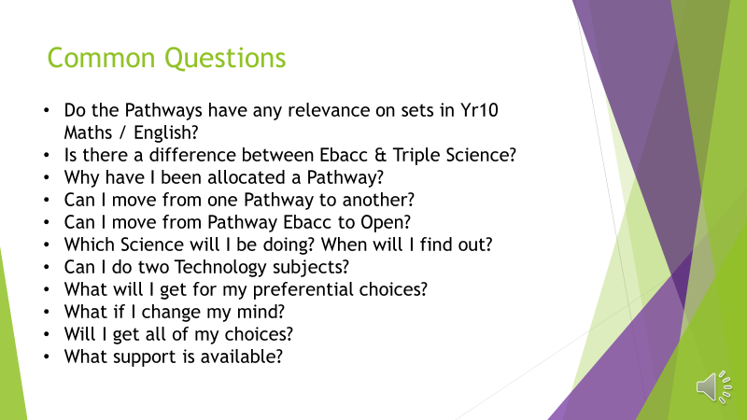

Slide 16
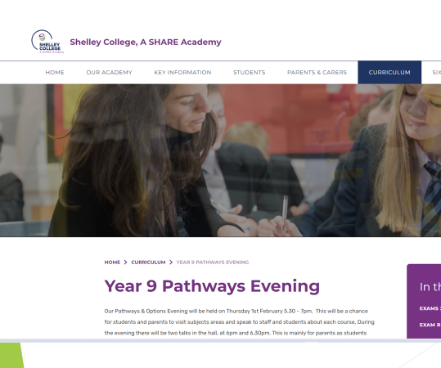

Slide 17
What do I do next?
Options Evening 29/01/26
Ask teachers, tutors
Discuss at home
Read information on the website
Consider careers and your pathways
Choose your options & reserves wisely

Slide 18
Thank you for listening.

