Slide 1

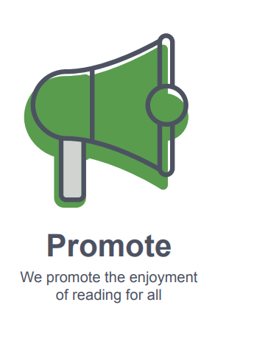
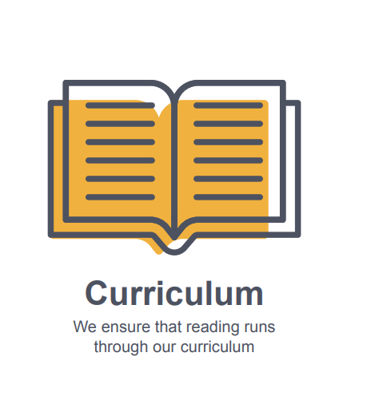
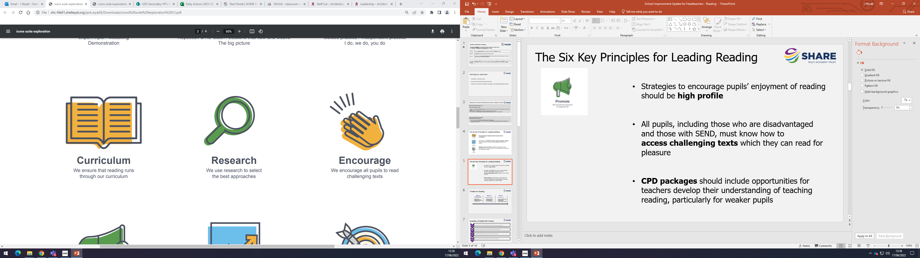
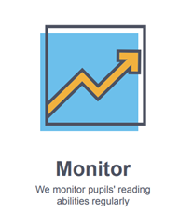

The Six Key Principles for Reading
Strategies to encourage pupils’ enjoyment of reading are high profile
The teaching of reading permeates the curriculum - All subjects have integrated reading into their curriculum and staff are well equipped to support students with reading and decoding.
1.
4.
All pupils, including those who are disadvantaged and those with SEND, know how to access challenging texts which they can read for pleasure
Mechanisms to identify and then support weaker readers take place on entry and throughout pupils' time in school
2.
5.
CPD packages include opportunities for teachers develop their understanding of teaching reading, particularly for weaker pupils
Reading catch-up plans are implemented which address the core areas of need. These should focus on phonics for early-stage readers.
3.
6.

