Slide 1






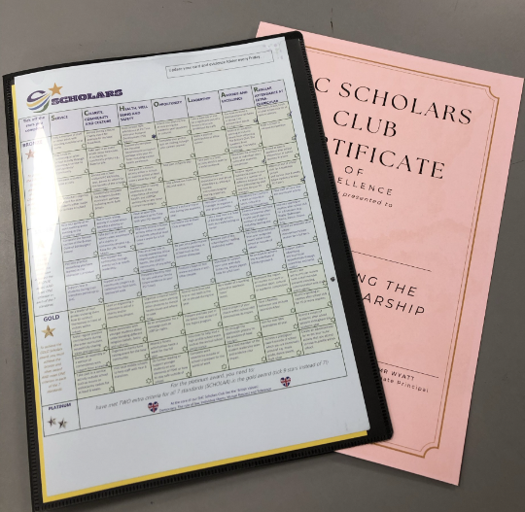








Your SHC Personal Development package
Valuing people and supporting personal best

Slide 2

THE SCHOLARS CLUB – what is it?
One of the most important aspects of education is the opportunity to experience things outside the classroom which will help you to develop personally as well as academically.
Our school has a rich tradition of providing students with experiences and enrichment activities ranging from The Duke of Edinburgh Awards, to GoApe visits, to Boxing Club!
‘The SHC Scholars Club’ is a set of 7 standards that you will all work towards to develop you personally throughout your time at school with us.
These standards cover important aspects of personal development that will help you become confident, happy, resilient young adults.
To fulfil the seven standards during the time students are with us, all you need to do is get involved in some of the clubs, trips, visits, school productions and many other things that go on at Shelley College :)

Slide 3
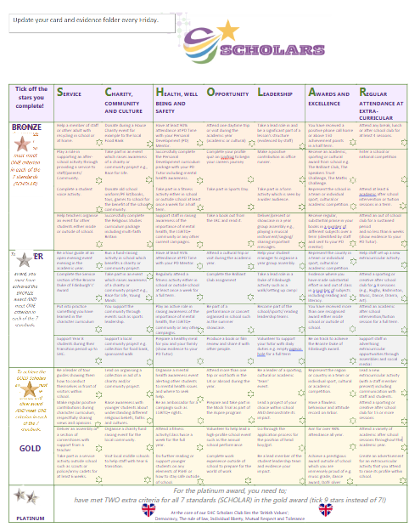

How will we track your involvement in the SHC Scholars Club?
This is your personal record of achievement.
Use your folder to show off what makes you unique and brilliant.
SCHOLARS is about everything you do beyond the classroom.
Take your SCHOLARS folder to any future interviews.
Tick off the stars as you complete a criteria for each standard

Slide 4
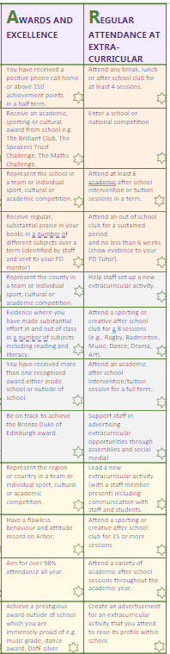
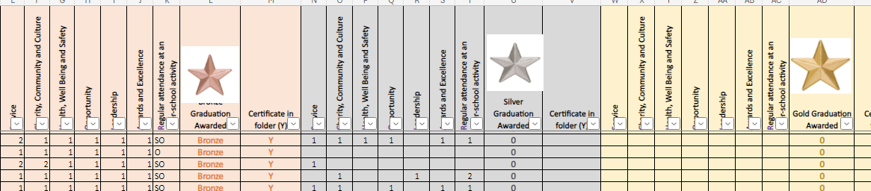
Weekly focus- Awards and Extra-curricular
Things you could do to tick off 'Awards' or 'extracurricular' on your Scholars card:
Try out a new club with your friends and get your name on a register
Attend intervention sessions for any subject
Gain more positive points each week
Represent the school at a sporting event
Complete DofE Bronze sections
Get a subject certificate or award
Update your tracker card and let your tutor know!

Slide 5
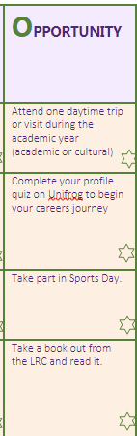
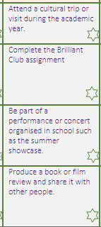
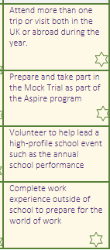
Weekly focus- Opportunity
Things you could do to tick off 'Opportunity' on your Scholars card:
Attend a college open evening or event looking at your next steps
Be a part of a sports fixture e.g. Shelley Football team
Take part in an event, workshop or trip
Meet with our careers adviser to discuss future education and career plans
Update your tracker card and let your tutor know!

Slide 6


Will you be one of our next graduates?
Your SCHOLARS folder is a record of all your achievements beyond the classroom
This is your record of participation in events, trips, clubs and charitable work outside of the classroom
You can include evidence of activities you participate in outside of school too
Pupil progress will be awarded with certificates and badges as the progress through each standard

Slide 7
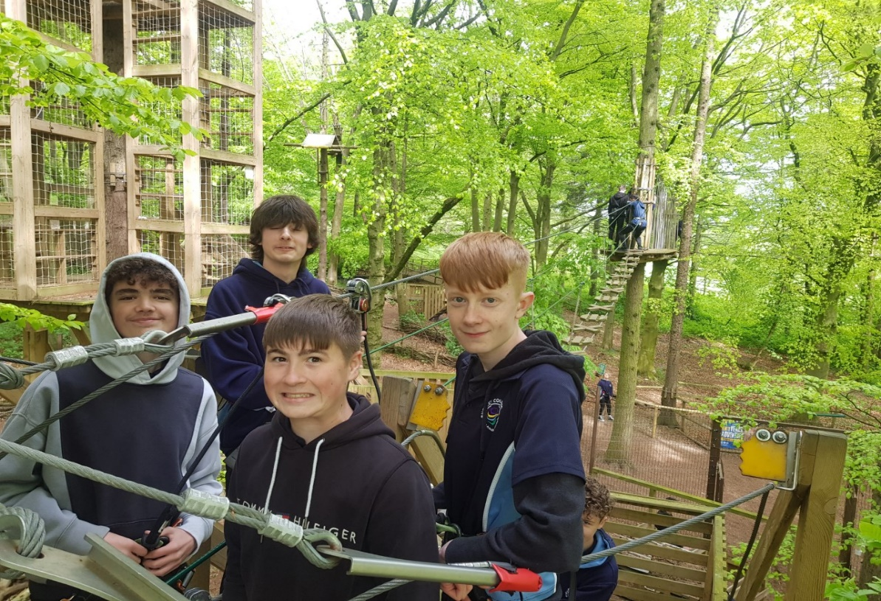
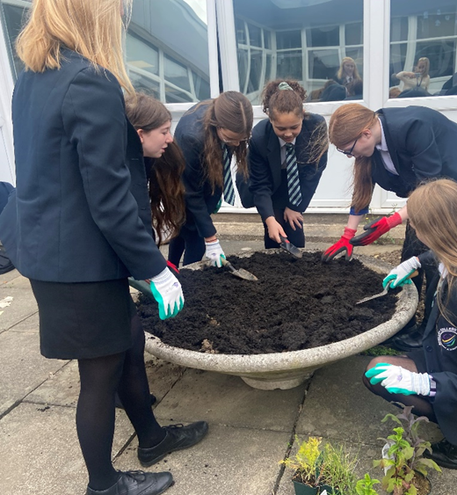
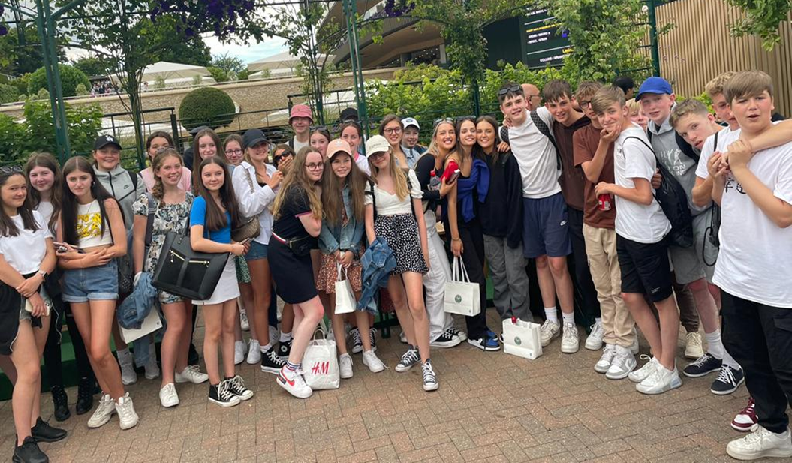
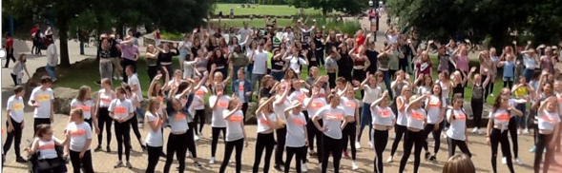
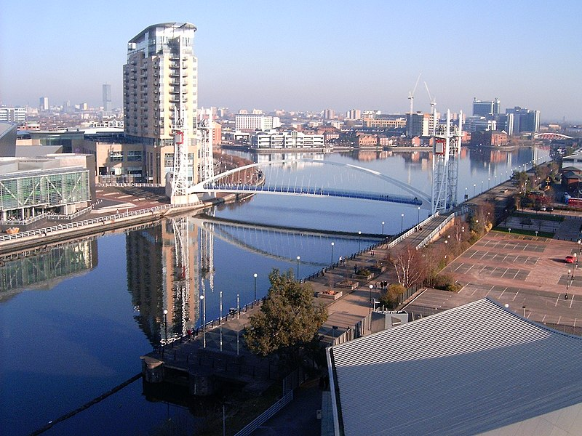
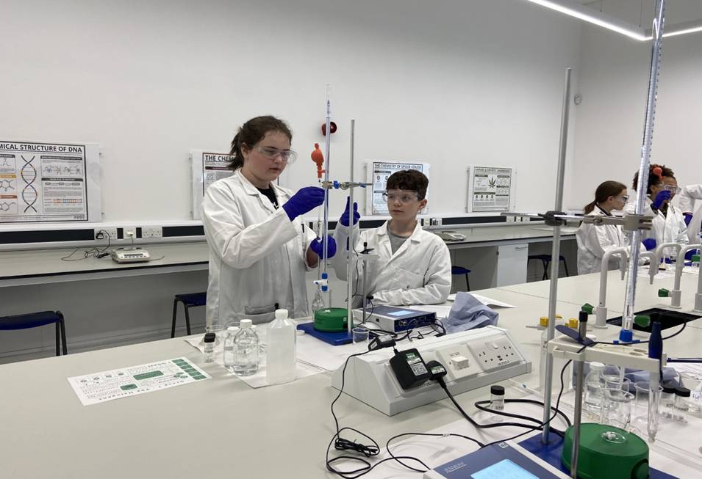
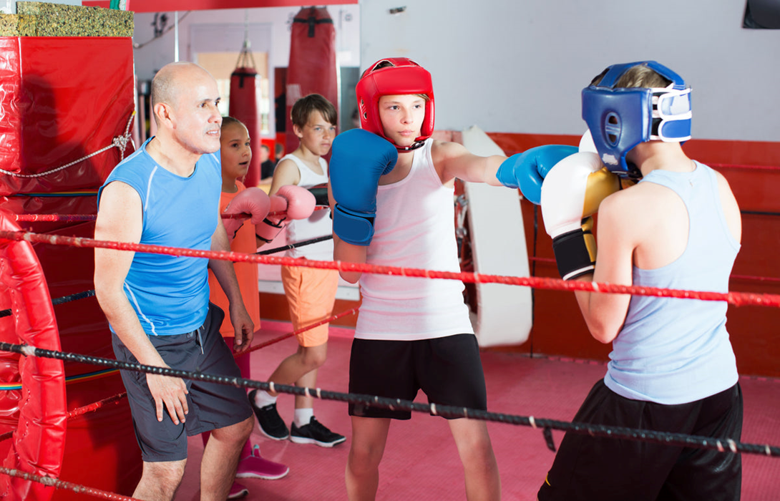

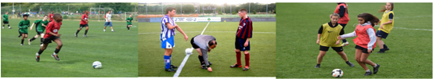
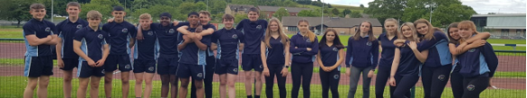
Update your cards and plan your next SCHOLARS goals
The opportunities in The SHC Scholars Club are endless!
Get involved!
Graduate with flying colours this year!
The more you participate the more you will develop your character and the more rewards you could gain!
Get involved in clubs, trips and charity events

Slide 8
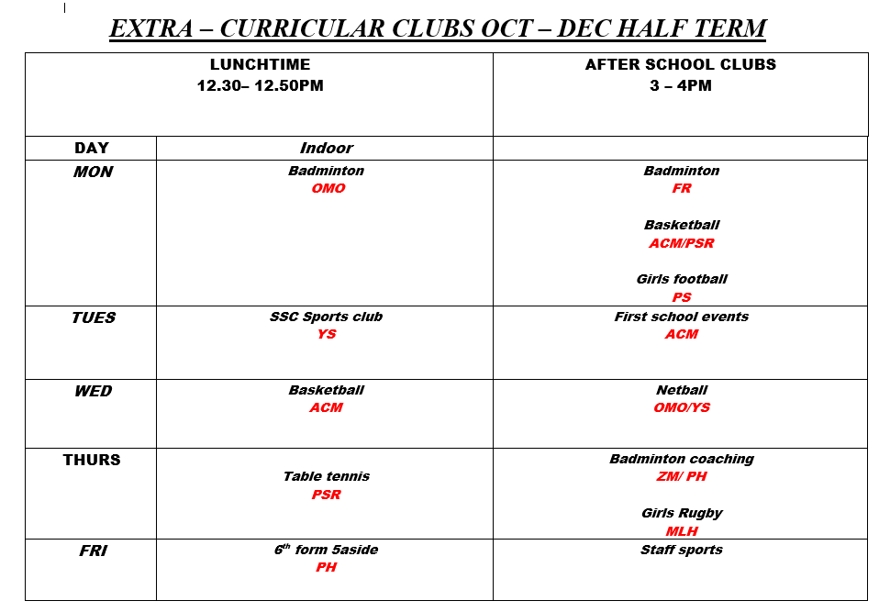
Your next steps:
Read through the SCHOLARS card and see what you can already evidence e.g. have you already attended some clubs? Did you help with Year 8 open evening? Have you been an office runner or helped your tutor with recycling or emptying the pigeon hole? Are you a member of the student leadership team?
The possibilities are endless!
Check out what clubs and activities are happening. Go and try some out and get your name on the club registers
Check your social area notice boards for all club details

Slide 9


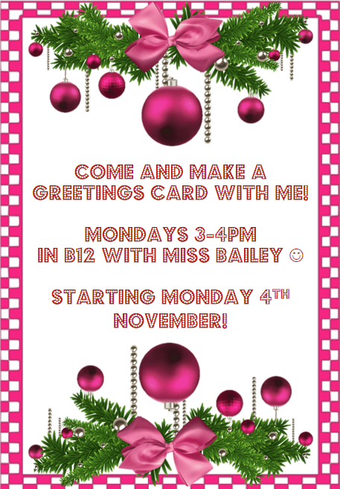
New clubs for HT2!
Debate club
Monday 3-4pm
All welcome
B10a
Check your social area notice boards for all club details

Slide 10

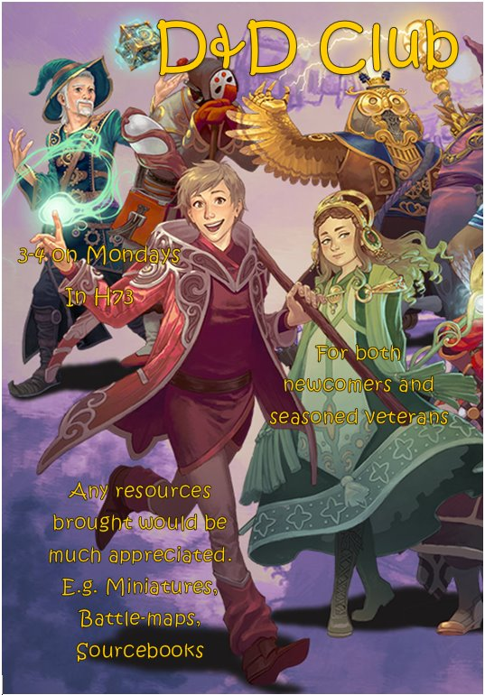
Chess club
Tuesday break
Friday 3-4pm
All welcome
Mr Stackhouse
E43
Eco school club
Tuesday break
All welcome
Mrs Walker B20a
Warhammer Club!
Thurs 3-4pm in E44 (art) with Mr Walker.
Learn to build, paint, collect and play Warhammer in a relaxed and friendly atmosphere. Open to all years, whether you are new to the hobby, or a seasoned veteran. We have free models and hobby tools available to new-comers provided by Games Workshop too!
D&D club
Monday
3-4pm
All welcome
H73

