Slide 1


The Curriculum offer at Shelley College
Valuing People, Supporting Personal Best
Mrs Thompson Assistant Principal & Mr Hewitt Assistant Principal

Slide 2
Welcome & tonight we will outline:
1. Our curriculum offer
2. Our curriculum implementation
3. Our assessment processes
4. Teaching & Learning at Shelley

Slide 3
From September 2019 a new approach to looking at educating young people.
Dept. for Education
Ofsted
New terminology: The Quality of Education which includes…
Intent
Implementation
Impact

Slide 4
The Year 9 Curriculum
Intent
The aim of this college is to provide opportunities for children to develop as independent, confident, successful learners with high aspirations who know how to make a positive contribution to their community and the wider society. There is a high focus on developing children’s moral, spiritual, social and cultural understanding. The academy ensures that children are well prepared for life in modern Britain.

Slide 5
The Year 9 Curriculum
Intent
We constantly pursue excellence in our curriculum through the following:
Our curriculum is designed and tailored to inspire and engage all students with a rich, broad and balanced experience, allowing students to develop the knowledge and skills to be successful in future life.
Our curriculum is designed and sequenced to gain new and retain consolidated knowledge each year.
Our curriculum exposes students to challenging concepts and trains scholarly independence and skills mastery for life beyond Shelley College.
We especially need to focus carefully on our disadvantaged students to help their life chances.

Slide 6


Slide 7
This year we are working hard to…..
Harmonise our Year 9 curriculum with the middle schools
Ensure that the National Curriculum is closely followed & exceeded where possible
Develop & sequence our curriculum plans
Concentrate on building knowledge & retaining ‘golden threads’
Ensure that there is no narrowing of the curriculum taking place

Slide 8
The Year 9 Curriculum
Traditional curriculum
2 week timetable Yellow/Blue
50 periods
Rooming
Teachers / Groups / bands
Sets
Languages French / Spanish
PD programme / Cornerstones

Slide 9
Assessment at Shelley College
How will I be assessed?
How often?
Will I receive feedback?
What will I be expected to do with this?
What support will I receive?

Slide 10
Recent Changes
Year 9
Students who start year 9 at Shelley in 2024 will be assessed under a 9-1 grade system for all of their GCSE subjects currently offered at Shelley
A Grade 5 is the new benchmark for a strong pass.

Slide 11


Slide 12
What grades should students be achieving?
The target grades are usually based on the actual marks achieved in the Key Stage 2 SATs.
You will be provided with your target grade in the first monitoring.
Target grades are used at school and at home to provide a measure of where you are in relation what we think you will achieve at the end of KS4.

Slide 13
Monitoring at Shelley College
What will this look like?
How often will monitoring go home?
How will curriculum change affect me?

Slide 14
Monitoring
Subjects on a 1-9 scale
Expected & Challenge Grades
Current Grade
Commitment to learning (RAGG*)
Attendance will be colour coded (RAGG*)
An explanation will be provided on the reverse side

Slide 15
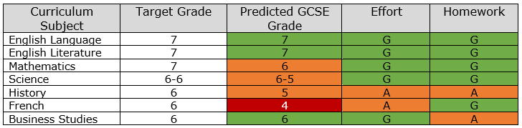
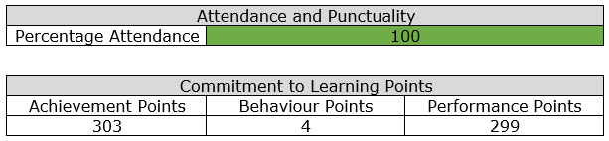

Slide 16
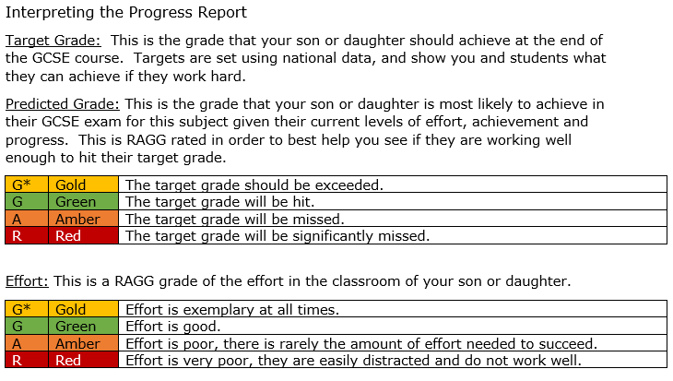

Slide 17
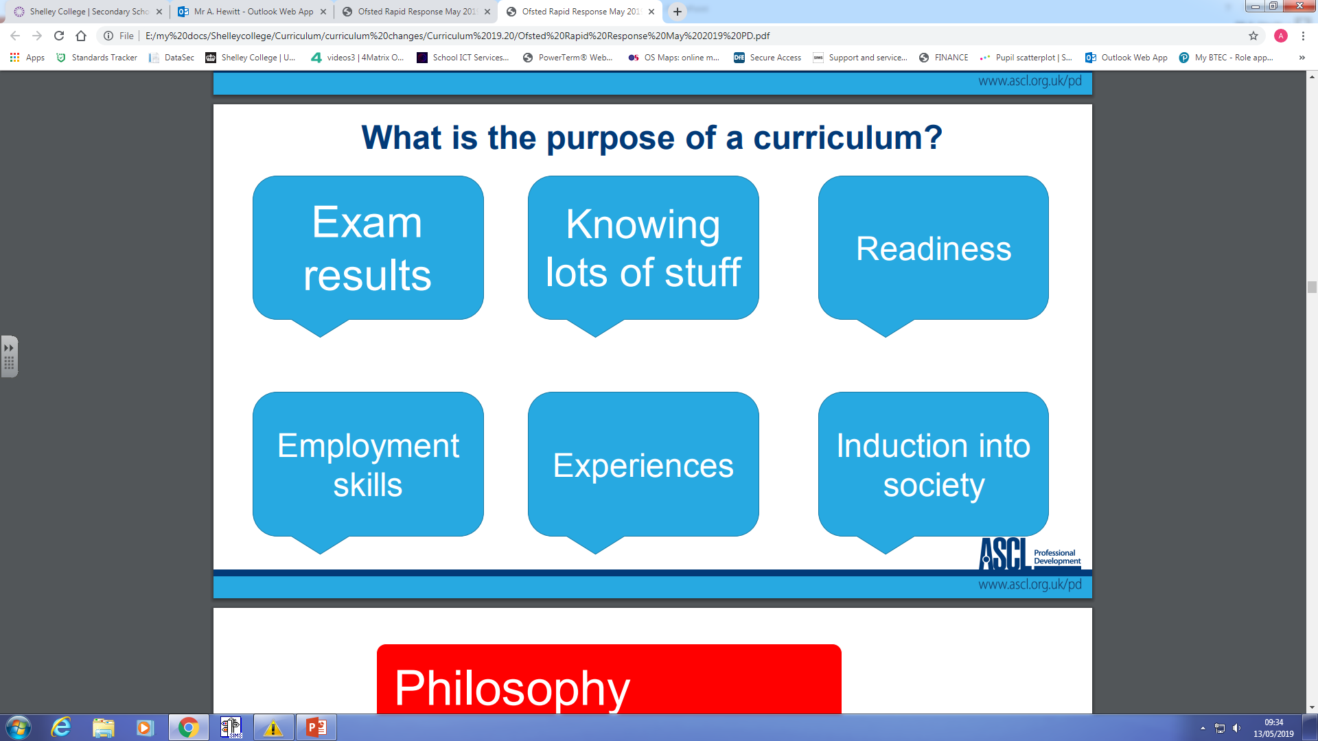

Slide 18

Teaching and Learning at Shelley College
Claire Thompson
Assistant Principal

Slide 19


Slide 20
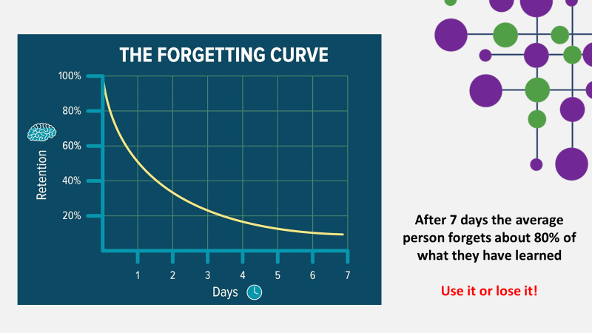

Slide 21
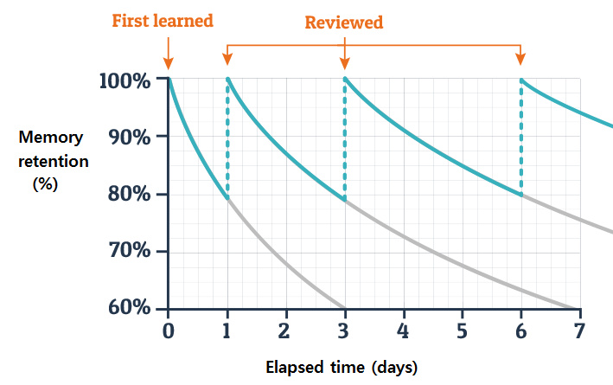
The Research
The more you revisit, the less you forget
The more you remember

Slide 22


Slide 23
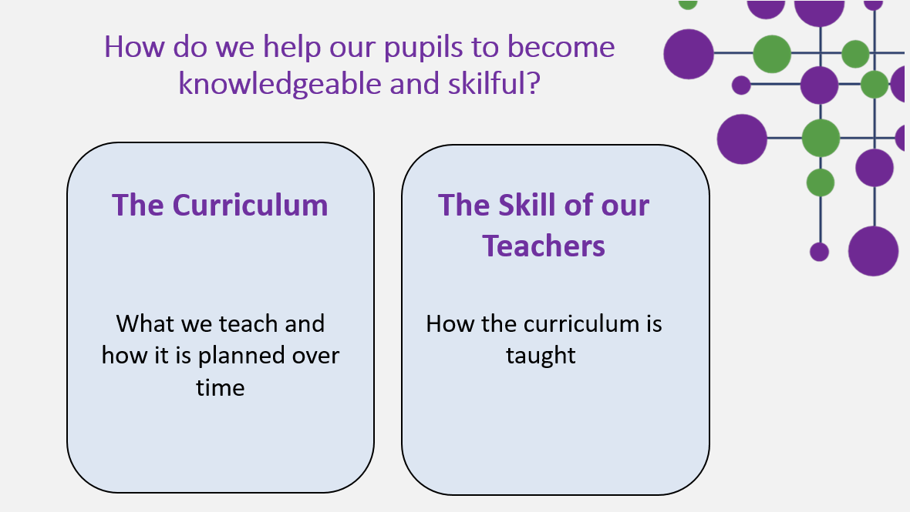

Slide 24


Slide 25


Slide 26


Slide 27

Skilful Implementation
Gain, Retain, Train
This is our teaching and learning philosophy. We help you to progress by supporting you to learn more, remember more and do more

Slide 28



The language that we use with pupils to support the teaching of new information is “Gain”
Teachers provide demonstrations
Teachers provide models which show you what pupils need to do
They select challenging and ambitious resources

Slide 29

How do teachers help pupils remember?
Lessons flow from one to the other
Teachers recap things often
They weave topics together

Slide 30
How do teachers help pupils develop what they know?
Your teachers show pupils what to do
Teachers provide opportunities to practice challenging and ambitious questions
Activities are closely matched to the concepts and information that pupils need to know and need to be able to complete

Slide 31
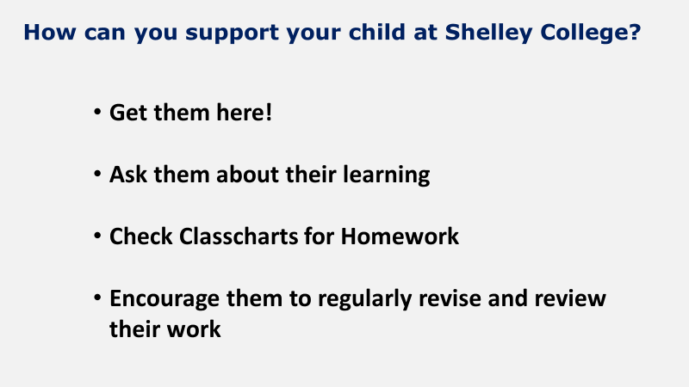

Slide 32


