Slide 1

Positive routines to support the exam season

Slide 2

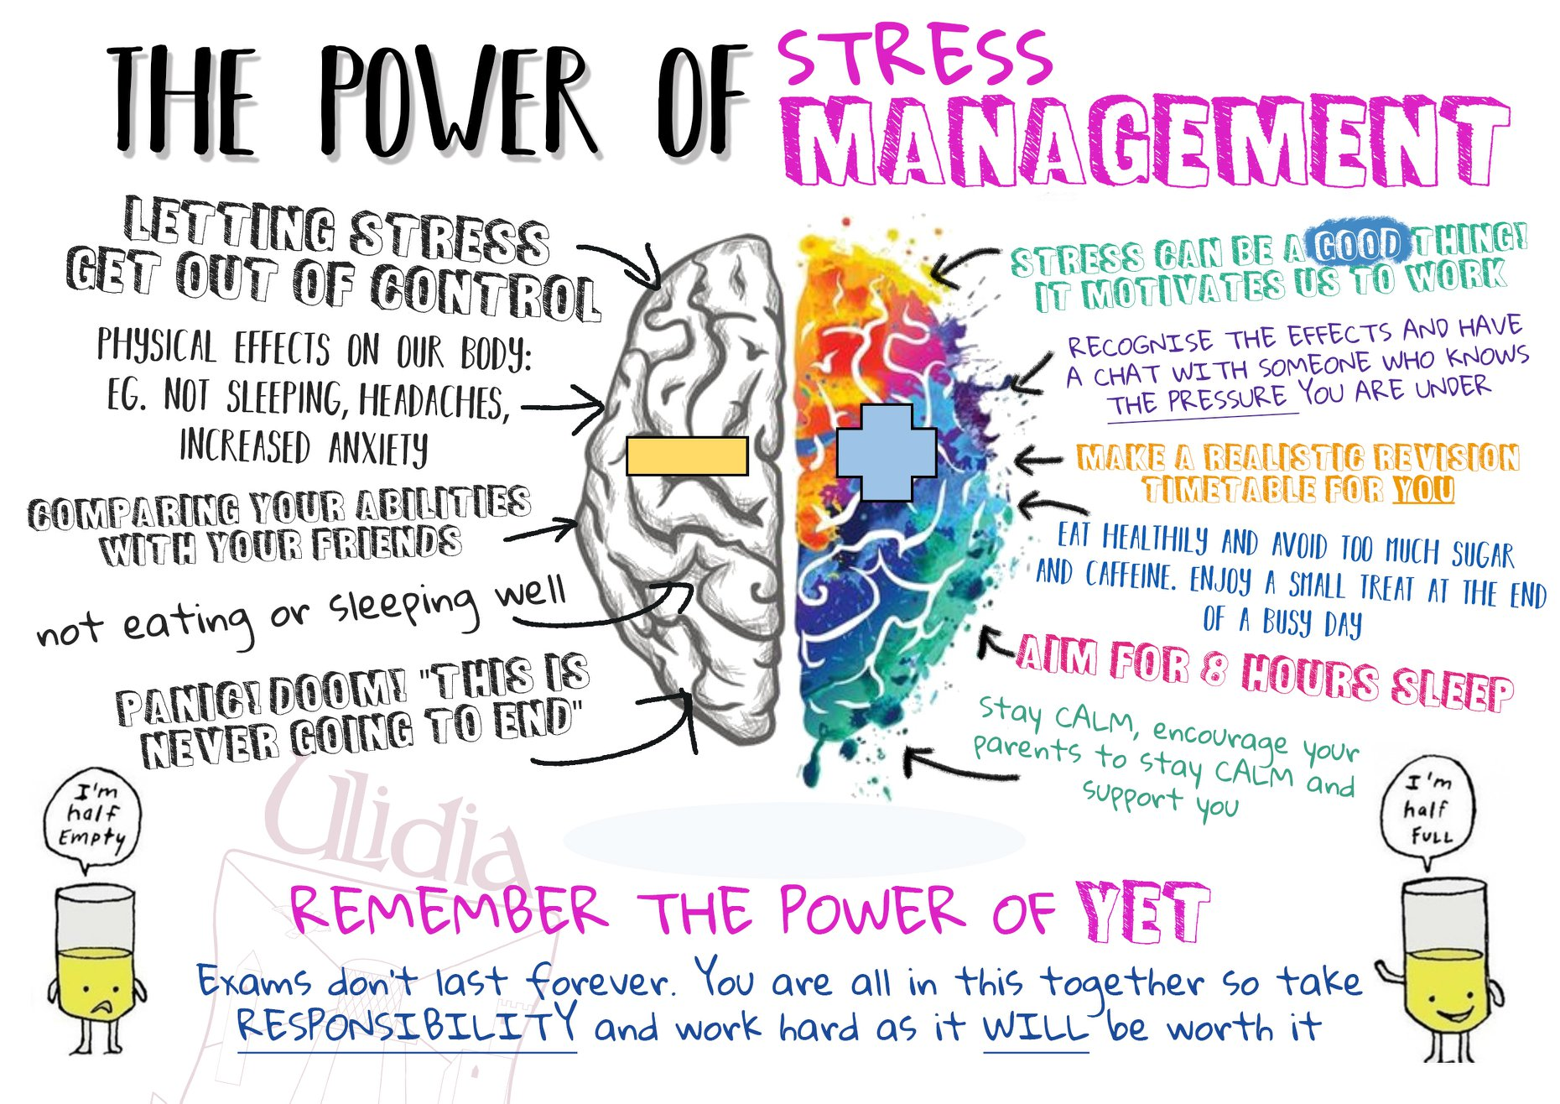
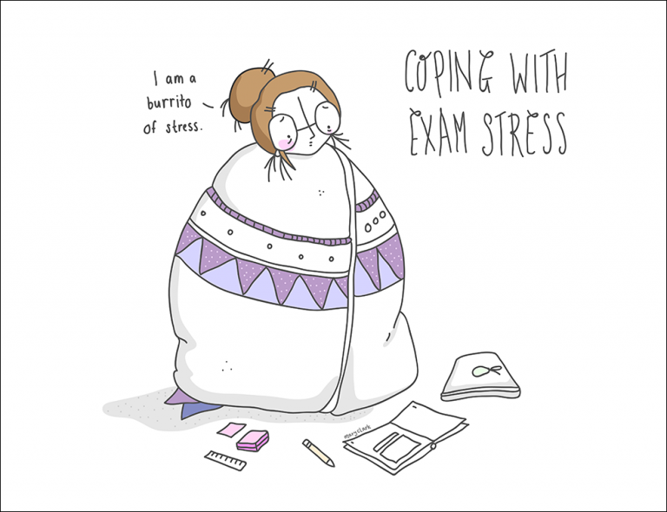
WHY?
Research has shown how a student’s mindset can influence their academic performance, and their ability to navigate challenges.

Slide 3

STRATEGIES
EXERCISE
Try to encourage them to get active. Even if only for 30 minutes a day. A walk, a run, anything. It will help the brain and the body too.
DIET.
Eating a balanced diet is important for energy levels and brain power. Try to encourage 3 meals a day, even if food the first thing in the morning isn’t their thing, offer a snack for break time.
SLEEP
8 hours is essential!
PLANNING.
Plan revision – This means where, what, and when, for how long, who with, and WHY.
BALANCE.
Try to balance good revision with good breaks. The cram just doesn’t work, and shouldn’t be a model we follow.
REMEMBER TO BREATHE
Practicing breathing techniques during an exam season can really help lower stress and anxiety levels. Simple techniques like breathing in and out in timed

Slide 4
STRATEGIES
SET REALISTIC GOALS
Encourage them to set realistic goals by understanding what they need to do to achieve their target grades. This means realistic goals on outcome, but also realistic goals by the amount of revision they can complete in one day/week/etc.
SELF-BELIEF
Constant self-belief is difficult – but during an exam season – big them up as often as possible. They can do it. If they think like that, they’ll do better than someone who doesn’t.
REWARD, LOTS
Extrinsic motivation is powerful in young people. Try to reward them as often as possible. Make the ordinary seem super special. Make deals with them. “If you can show me X,Y,Z – you can do this”
INDULGE SILLY
Linked to the above. Give them time to be kids. Let them do daft stuff between revision. Let them play. A balance is super important.
MAKE YOUR EXAM SEASON STRATEGY CLEAR TO FRIENDS AND FAMILY
Share the revision schedule with immediate family and make it the responsibility of all family members to hold them to account to it. If everyone buys in, it will become a family culture – and will feel more ordinary.
REMIND YOURSELF OF THE THINGS YOU DO WELL
Shower them with reminders about what they do well – who they are and what you love about them. It’s a stressful time and they will need the reminder that they are not defined by these results.

Slide 5

OVERALL
Encourage your child to take revision breaks and find a balance between studying and doing things they find enjoyable and relaxing
Reassure them – reinforce that you are and will be proud of them no matter what happens.
Set aside one to one time so that they can talk to you about any worries.

