Slide 1
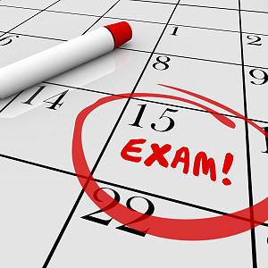

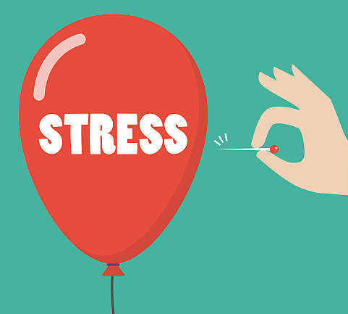
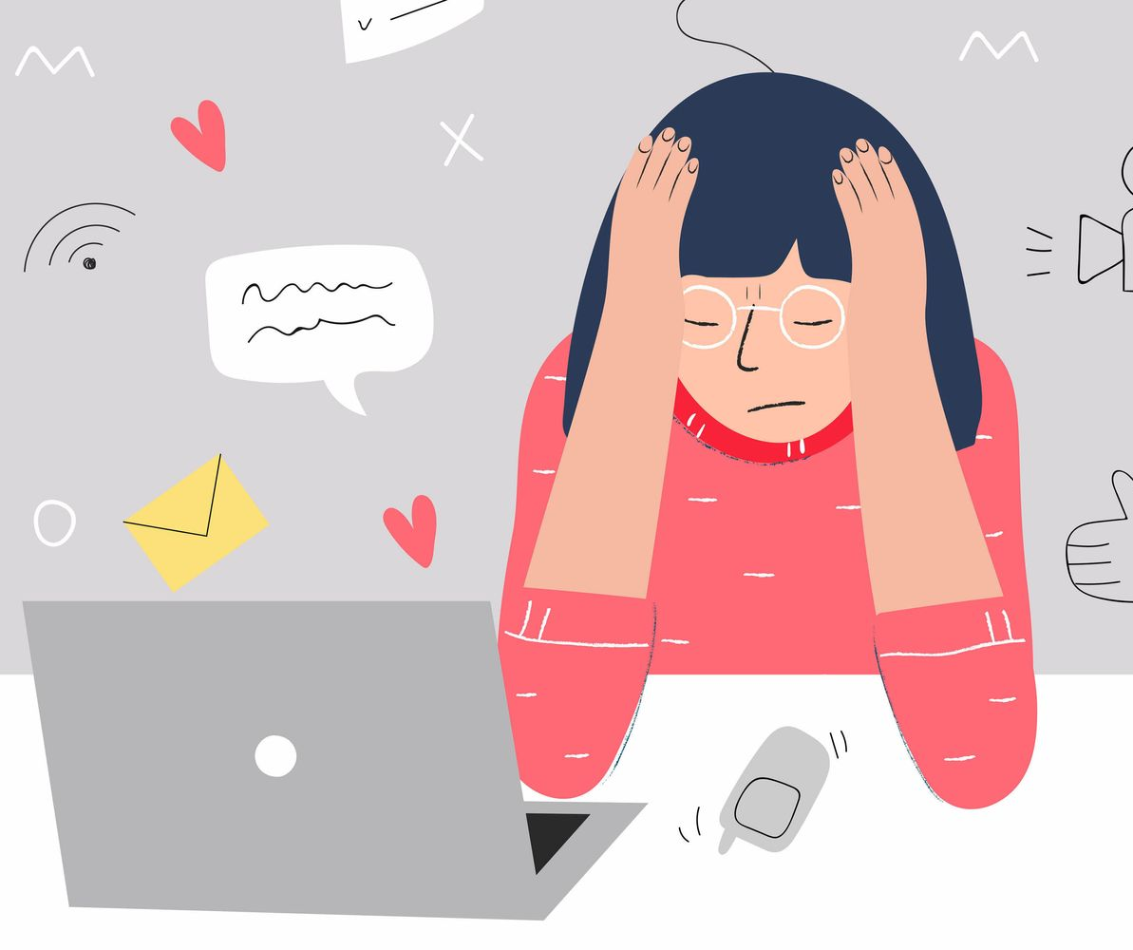
Preparing to
SUCCEED
Kim Modeste
Greg Wadsworth

Slide 2
Preparing to
SUCCEED
Exam & School support – Effective revision, organisation, homework, motivation, managing stress and workload
Online world – Managing social media, online bullying/abuse, addictions to electronics
Mental Health and Wellbeing – Healthy habits, school/life balance, support on offer
Stress, Anxiety and Worry – How to understand some key emotions that appear during school and life

Slide 3
Aim of our ‘Preparing to Succeed’ evening – why are we here?
Introductions
Exam & School support
Mental Health and Wellbeing
Stress, Anxiety and Worry
Online world
Where to go for further support and guidance – next steps
Q & A with pastoral, teaching and senior team after the talk has ended
Notes:
Exam & School support – Effective revision, organisation, homework, motivation, managing stress and workload
Online world – Managing social media, online bullying/abuse, addictions to electronics
Mental Health and Wellbeing – Healthy habits, school/life balance, support on offer
Stress, Anxiety and Worry – How to understand some key emotions that appear during school and life

Slide 4

How can we support students through tough times?
“It’s what you do in the dark that puts you in the light”

Slide 5

How can we support students through tough times?
“It’s what you do in the dark that puts you in the light”
Valuing People
Supporting Personal Best

Slide 6
Exam & School support
How do we help students to prepare for exams?
-Revision of knowledge
-Supporting emotions and worries
-Organisation and planning

Slide 7
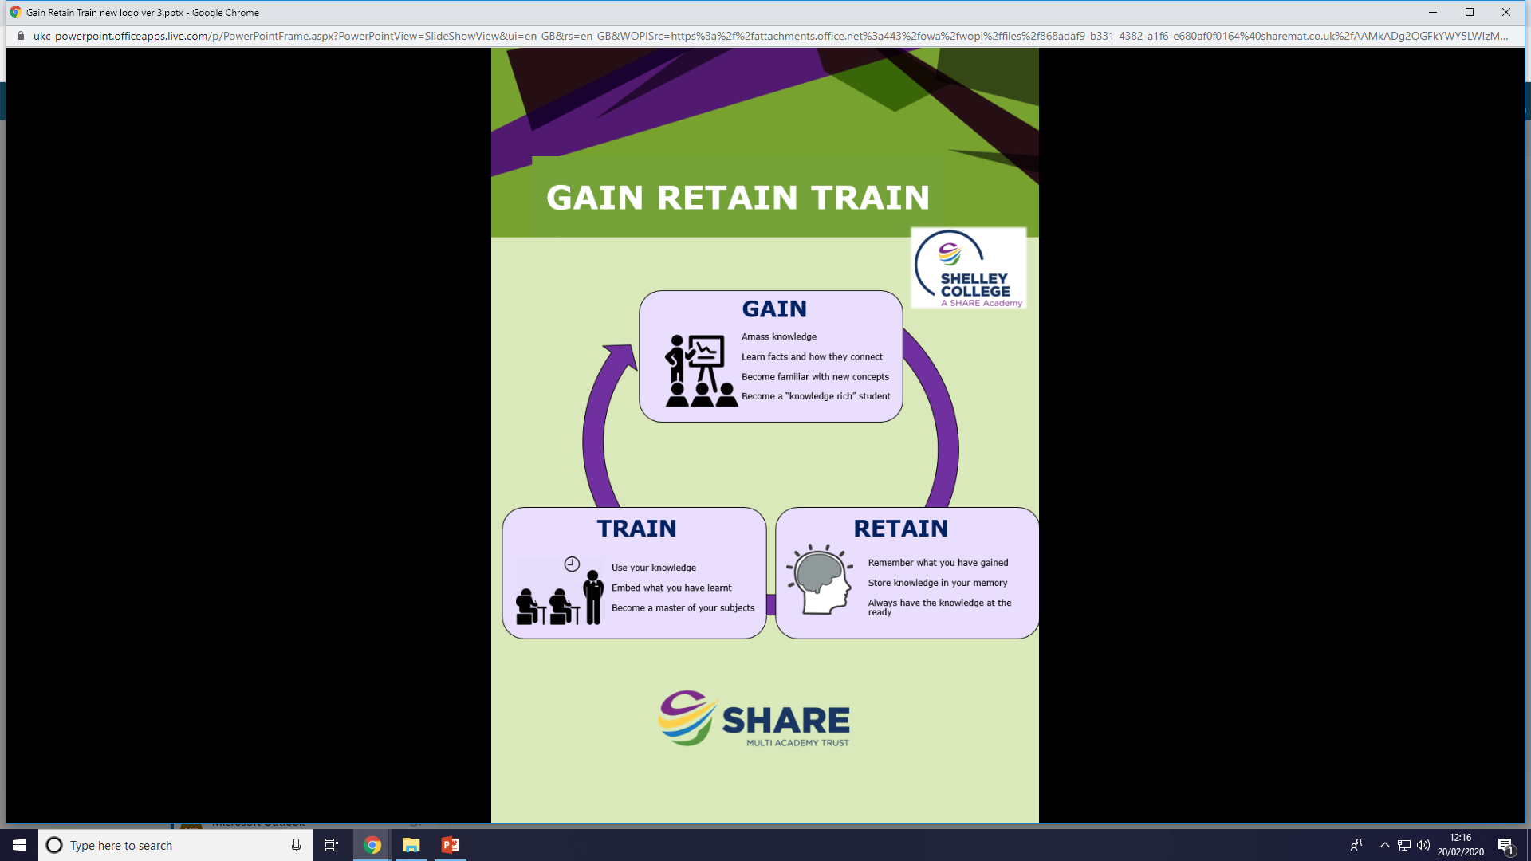
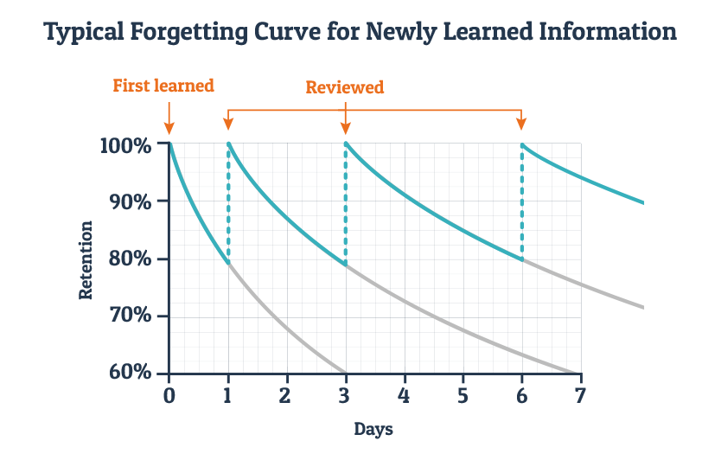
Exam & School support
Gain Retain Train
What does this mean and why do we do it?

Slide 8
Exam & School support
How to improve knowledge retention?
-Recap in lessons
-Homework
-Student revision
Forgetting knowledge and then revising it improves the brains ability to move knowledge into long term memory
“Learning happens because of repetition.”

Slide 9

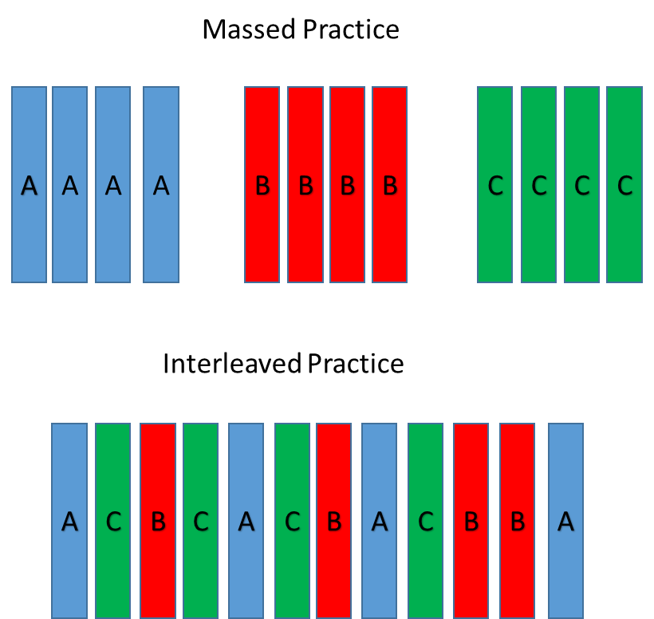

Exam & School support
How can I apply this to my own revision?

Slide 10
Exam & School support
Creating a revision timetable or plan?
-Ensuring you balance existing homework, coursework deadlines; family and friend social events; rest time
-Chunk it by topic; interleave and mix it up; test test test – but through low stakes Questions, flashcards, short answer questions etc
-Talk about it – talk through revision and ideas with friends, family so it's now all independent work
Ask for help and reassurance:
role of the family, role of friends and role of school

Slide 11
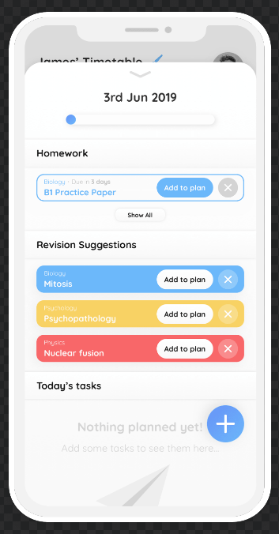

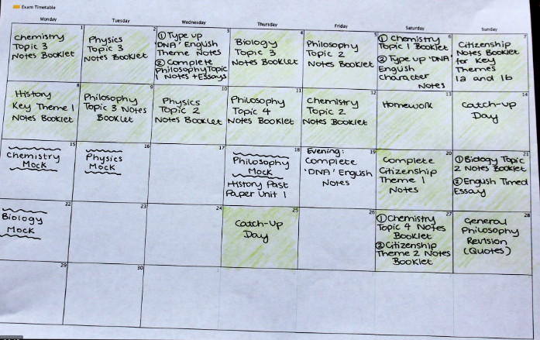
Exam & School support
Creating a revision timetable or plan?

Slide 12
Exam & School support
Careers/ Applications Support
-Will run until exams start in
-3-4pm in C31
Help with college applications, looking for apprenticeships, CV and cover letters, and job applications
- Extra support for parents/ carers at request, email Daniel.Watson@sharemat.co.uk

Slide 13
Exam & School support
Deadlines for local colleges
Shelley College -.
Greenhead College - .
Huddersfield New College –
Kirklees College
Barnsley College
For other institutions check their websites for specific deadlines.

Slide 14



Mental Health and Wellbeing Support
Friends and family
Emotional wellbeing support groups – referral from Pastoral Office
School – form tutors, subject teachers, pastoral team, Well-being team, senior team
School nurse - Through a referral from the Pastoral Office
Online services
www.kooth.com (Free online emotional wellbeing and counselling support)
https://youngminds.org.uk/ (Mental Health support website)

Slide 15

Mental Health and Wellbeing Support
Creating the right atmosphere for success
Get plenty of sleep
Eat well
Avoid alcohol, smoking and drugs
Get plenty of sunlight
Manage stress
Activity and exercise
Do something you enjoy
Connect with others and be sociable
Do things for others
Ask for help

Slide 16
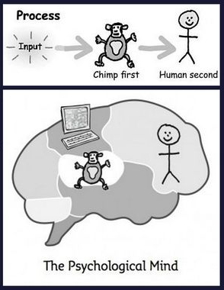

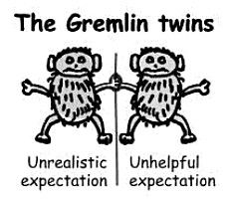
Understanding my inner chimp – Managing emotions
Motivation and procrastination
Outburst of emotions –anger, tears, anxiety, stress, worry
Struggle to see things in perspective or see the bigger picture
How to manage the chimp?
-Exercise the chimp -Box off negatives/uncontrollable -Bananas

Slide 17
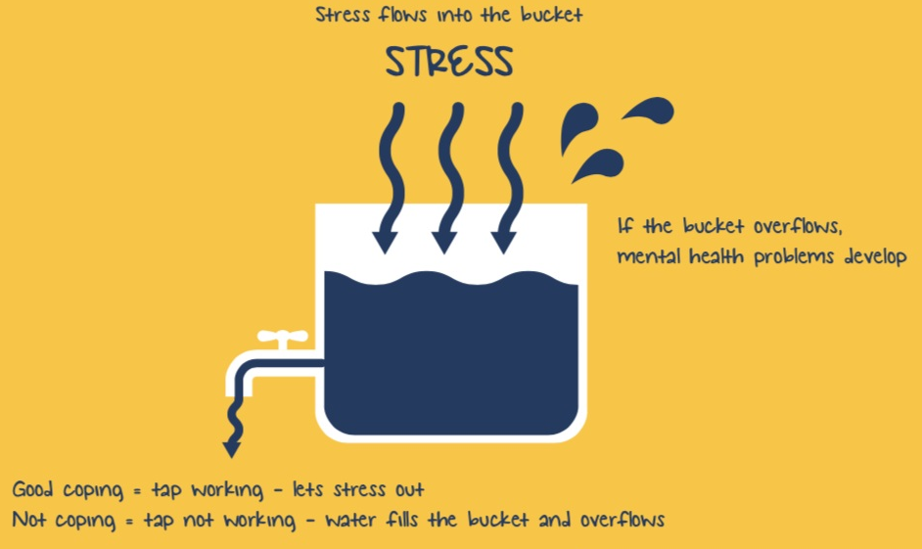
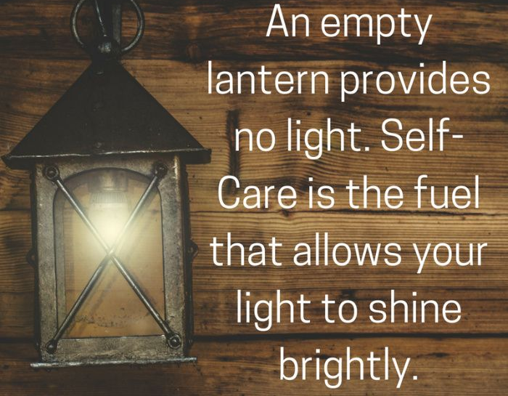
Understanding my inner chimp – Managing emotions
Stress and worry bucket
What are helpful coping mechanisms?
What are unhelpful coping mechanisms? Factors outside my control.
Importance of looking after yourself

Slide 18
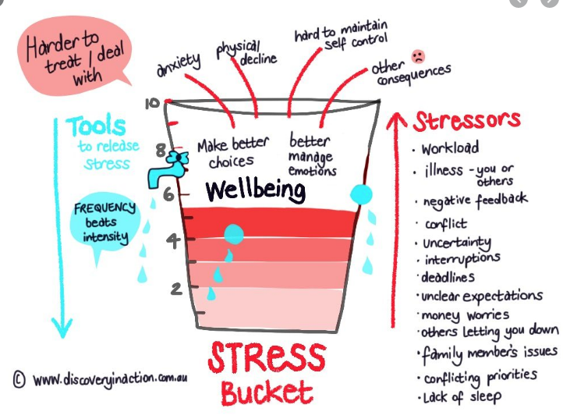
Understanding my inner chimp – Managing emotions
Students with anxiety

Slide 19
Students with anxiety
– Managing emotions around exams
Talk to your child about anxiety, what is happening in their body and why it happens. Many children and young people don’t know what they are feeling when they are anxious, and it can be very frightening and overwhelming.
Help them to recognise anxious feelings so they can tell when they are becoming anxious and can ask for help. Distract them by focusing on something else. Give them a cuddle or hold their hand if they will let you - touch can be soothing.
Tell your child it will be okay, and the anxiety will pass. It can be helpful to describe the anxiety as a wave to ride or surf that gets smaller after it peaks.
Encourage your child to notice what makes them anxious. Talking it through can help but your child could also try keeping a diary or a ‘worry book’ or 'bucket'
Work on positive-thinking. Name their worst case scenarios and think through together how to sort out the situation if it happens, e.g. ‘I’m worried that we’ll miss the bus.’ ‘What do you think we could do if that happens?’ ‘We could get the next bus’.
Help them maintain a healthy lifestyle with regular exercise to reduce the levels of stress hormones, good sleeping habits, calm bedtime routines, limited screen or computer time in the evening, and a healthy diet.

Slide 20
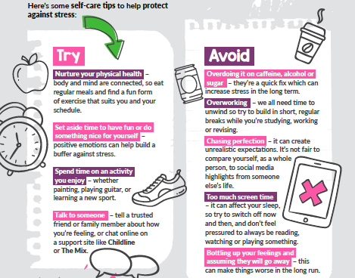
Title

Slide 21


Attendance and punctuality

Slide 22

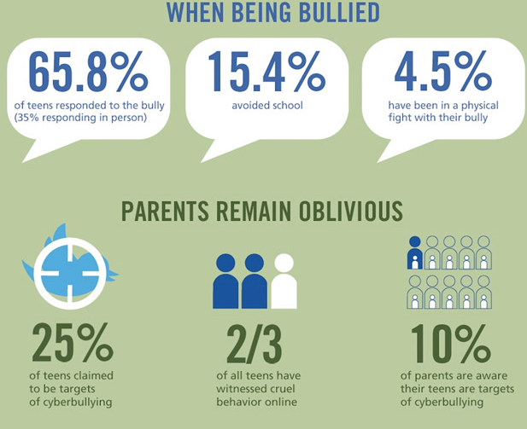

Online world and Social Media – Staying safe online

Slide 23

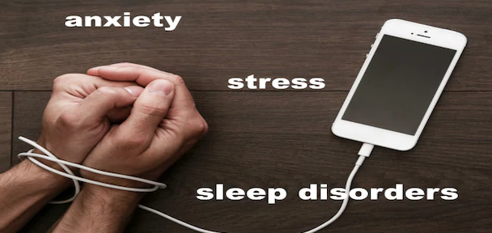
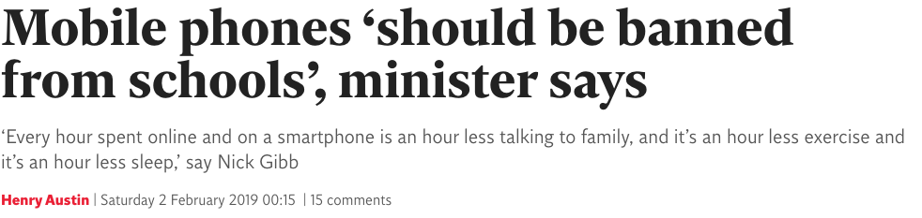
Online world and Social Media – Staying safe online
Having some phone free time each day – preferably switching off around 2 hours before bedtime.
Plan to meet friends, families etc in person more often rather than living online 24 7
Use of mobiles and electronic devices in school – From today this is being reduced further due to: Unhealthy balance, unhealthy addictions, reducing risk of cyber bullying, removing the chance of distraction from learning even further

Slide 24


Recap and next steps
Question and Answer – Come and speak with the team if you need to
We are here to support and offer guidance.

