Slide 1
How can I support my child to remain on top of their revision?
Luke Rushforth

Slide 2
What do you think the biggest barriers are to children revising successfully?

Slide 3
Building good habits
Creating a positive learning environment
Participating in revision
Praise and accountability

Slide 4
Building good habits

Slide 5
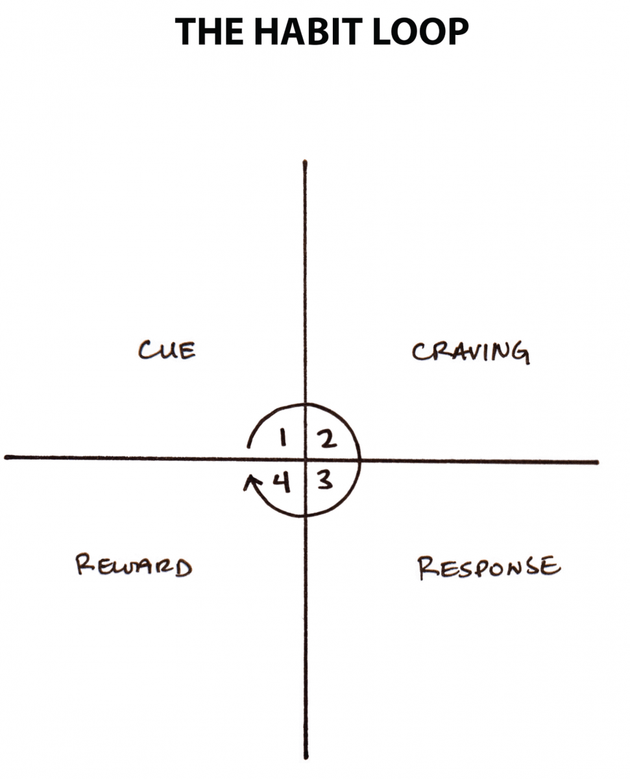

Slide 6
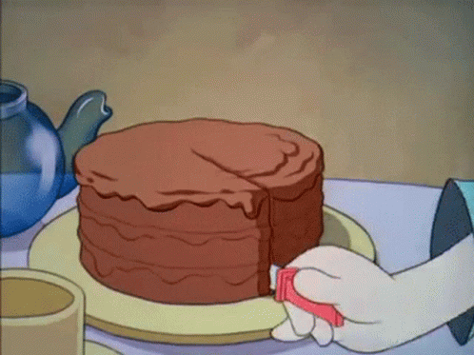

Slide 7
Cue – arriving home from school
Craving – PlayStation/TV/Going out with friends
Response – Act on craving
Reward – Brief dopamine release/(Temporarily) avoid revision

Slide 8
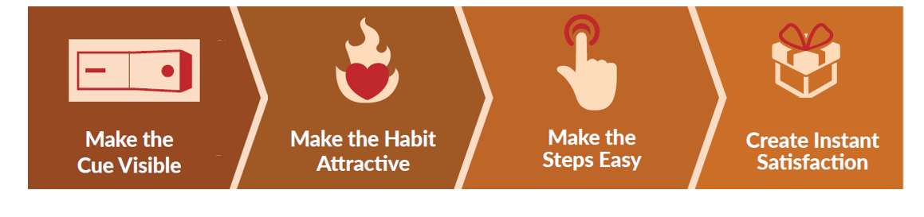

Slide 9
Revision resources on table visibly ready.
Child knows they will receive a positive response from starting revision/Earn some other reward.
Resources easy to access, minimise barriers and distractions.
Lots of praise!
A reward – seeing friends, PlayStation etc.

Slide 10
Cue – arriving home from school
Craving – desire to complete revision
Response – structured revision for an hour
Reward – Praise, free time etc.

Slide 11
Creating a positive learning environment

Slide 12
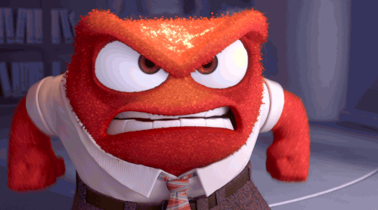

Slide 13
Create a quiet place to work
Everything needed is close by an easy to access
No distractions
Praise and positive reinforcement

Slide 14
Participating in revision

Slide 15
Ask your child what and how they are revising
Be inquisitive and interested
Get involved and help where you can (flash cards, teacher/student sessions)

Slide 16
Praise and Accountability

Slide 17
Praise all effort, regardless of the amount!
Positive and sincere praise can be incredibly uplifting and motivating
Tackle difficult situations with a positive mindset and with positive language

Slide 18
Luke.Rushforth@sharemat.co.uk

