Slide 1
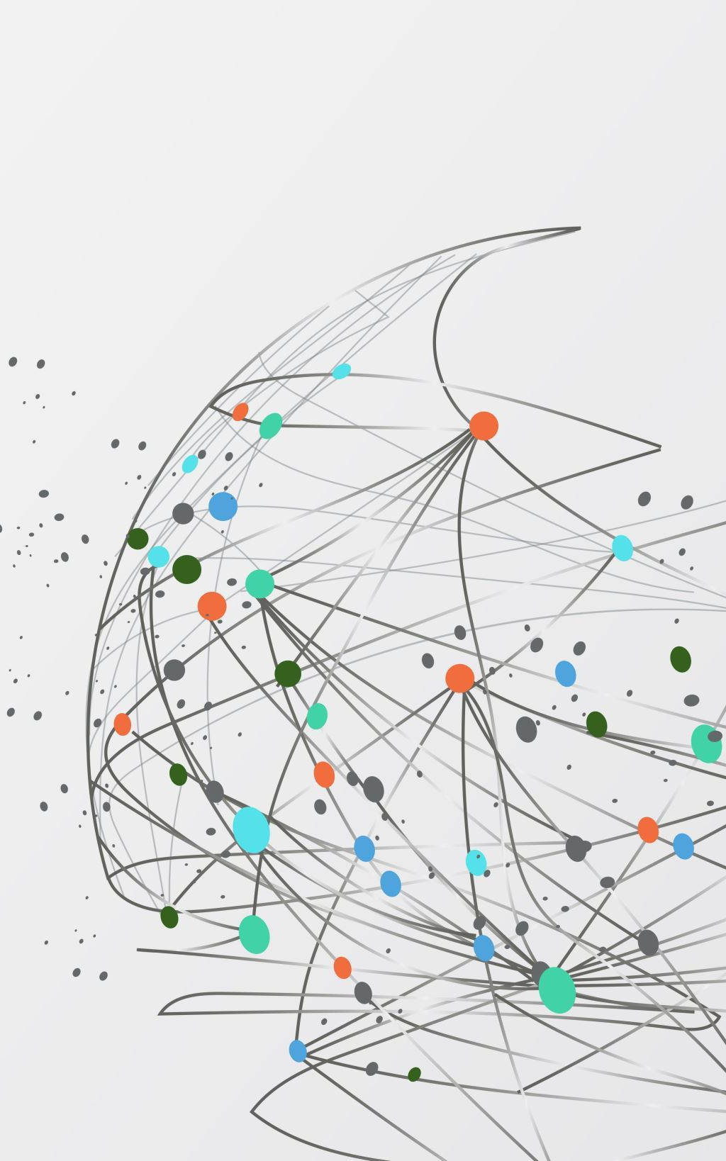
What do effective study habits and revision techniques look like?
Emma Martin
Vicky Caine

Slide 2

Effective Revision
IS spaced out, e.g. do 30 mins of Maths, 20 of English and 10 of Science on one day, rather than a full hour of science.
IS regular
IS chunked, e.g. you only revise one topic, rather than the whole subject
IS purposeful and focuses on the things you can’t remember easily
IS actively doing a task
IS testing your memory

Slide 3
3 revision techniques that are easy but are LEAST effective
Highlighting text
Re-reading notes
Summarising text

Slide 4

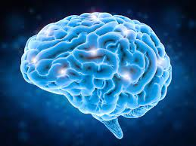
How does the brain work?
Your brain processes information at 268 miles per hour
There are 100 billion nerve cells in your brain capable of processing information
Your brain can store 2.5 million giga bytes of information
Faster than an F1 car
It would take more than 3,000 years to count them all
More than 150,000 Apple iPhones of storage

Slide 5
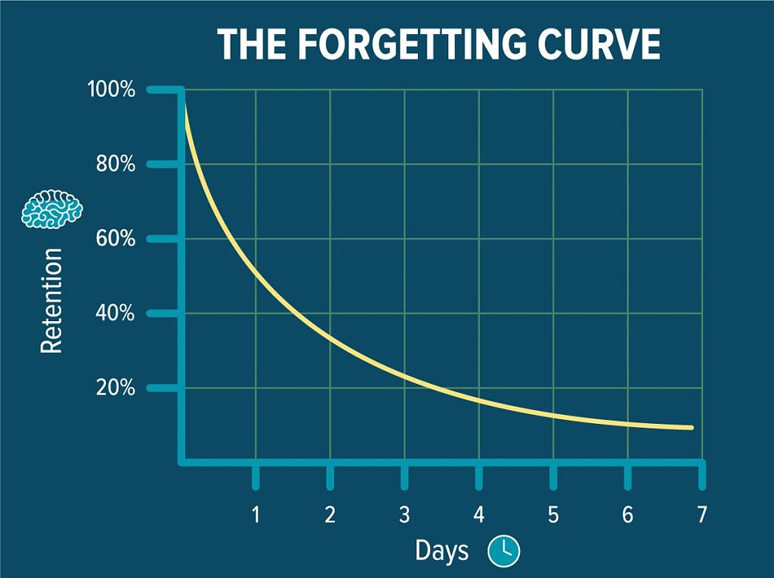
How does the brain work?
After 7 days the average person forgets about 80% of what they have learned.
This isn’t very helpful for exams, which is why revision is the key to success.
Use it or lose it!

Slide 6
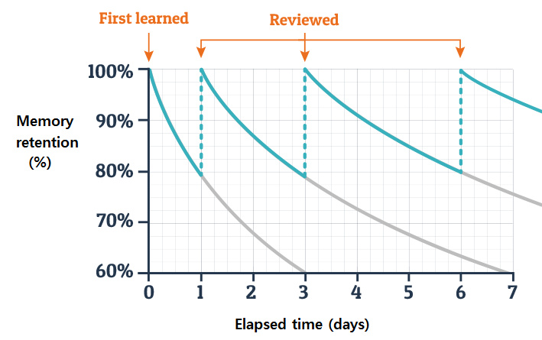
How does the brain work?
Research suggests that increasing the space between instances of remembering helps you to retain more information.

Slide 7

How does the brain work?
Think of revision like training a muscle – it strengthens the ‘muscle’ in your brain which can take things from long-term storage into actively being used.
The more you test your memory of topics, the more you will remember. Just like the more reps you do with weights, the more weight you can lift.

Slide 8

In Cornerstone, Year 11 students have learnt about revision techniques and applied them to different topics and subjects.

Slide 9

Flashcards
You can either have:
Questions and Answers
A series of prompts for a topic area.
Convert A3 mindmaps into A4, then A5, then flashcard points.
How to use flashcards:
You can use the Leitner Method: https://tinyurl.com/FlashcardsMethod
You can make flashcards online/on your phone using Quizlet

Slide 10
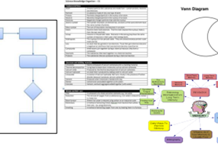
Knowledge Organisers
Transform your notes/information into visual revision material. Use them to:
Show links between topics
See whole topics in one diagram.
See comparisons between approaches or research.
Create flow diagrams for long answers

Slide 11

Dual Coding
Use your knowledge of Memory to your advantage. Create revision material that have images AND words so that your brain can process information to the best of its ability

Slide 12

Practice questions
Once you’ve learnt content, test yourself with exam questions. AQA/Edexcel/OCR will have several practice papers and mark schemes available on their website.

Slide 13
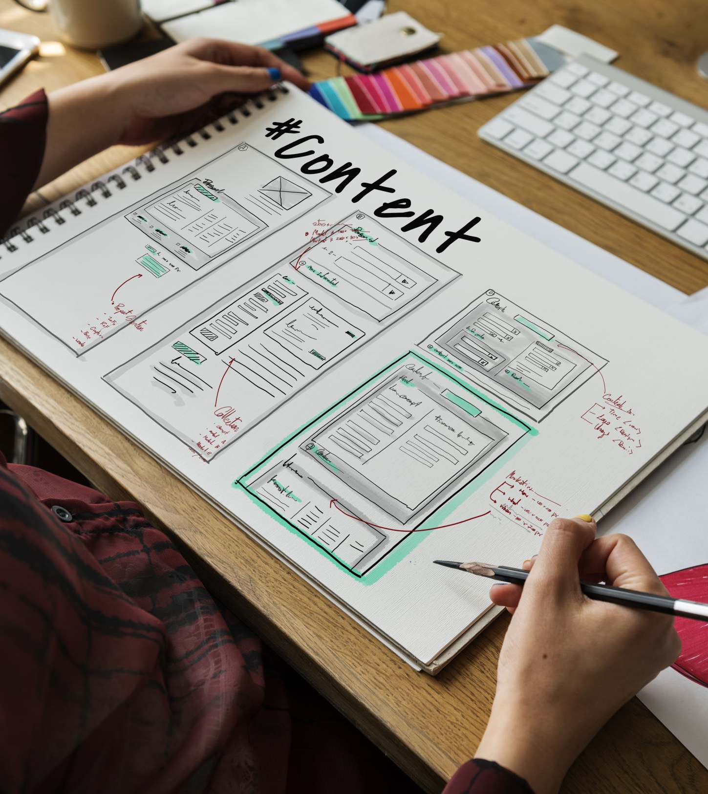
Test and teach
Create quizzes or attempt premade ones. It’s the easiest way to find out your weakest areas.
Great websites include:
• Quizlet
• Kahoot
• Seneca
• Gojimo (App)
• Get Revising

Slide 14
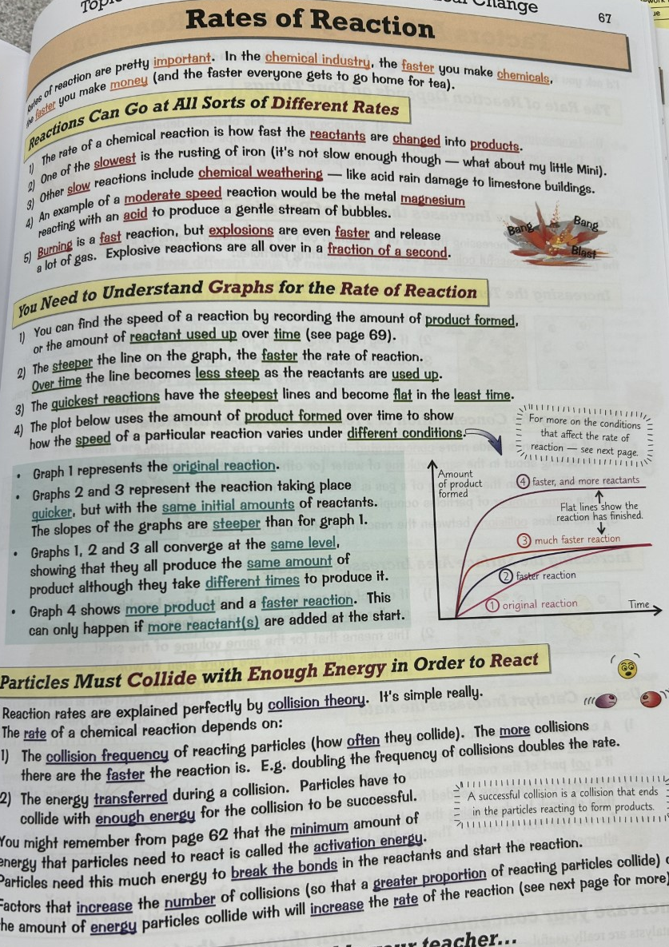
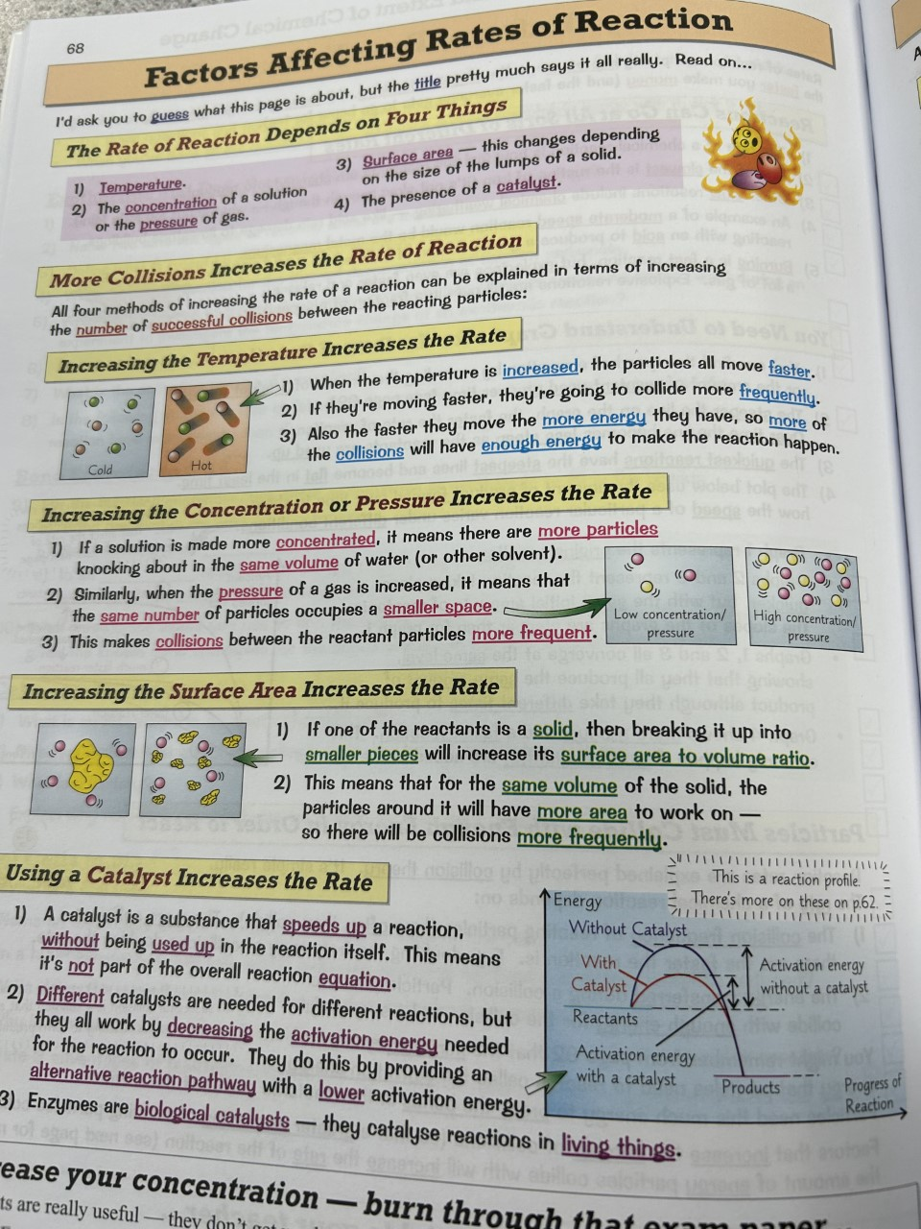
Worked Example
Step 1: collating knowledge
Reliable Sources
Small Chunks

Slide 15
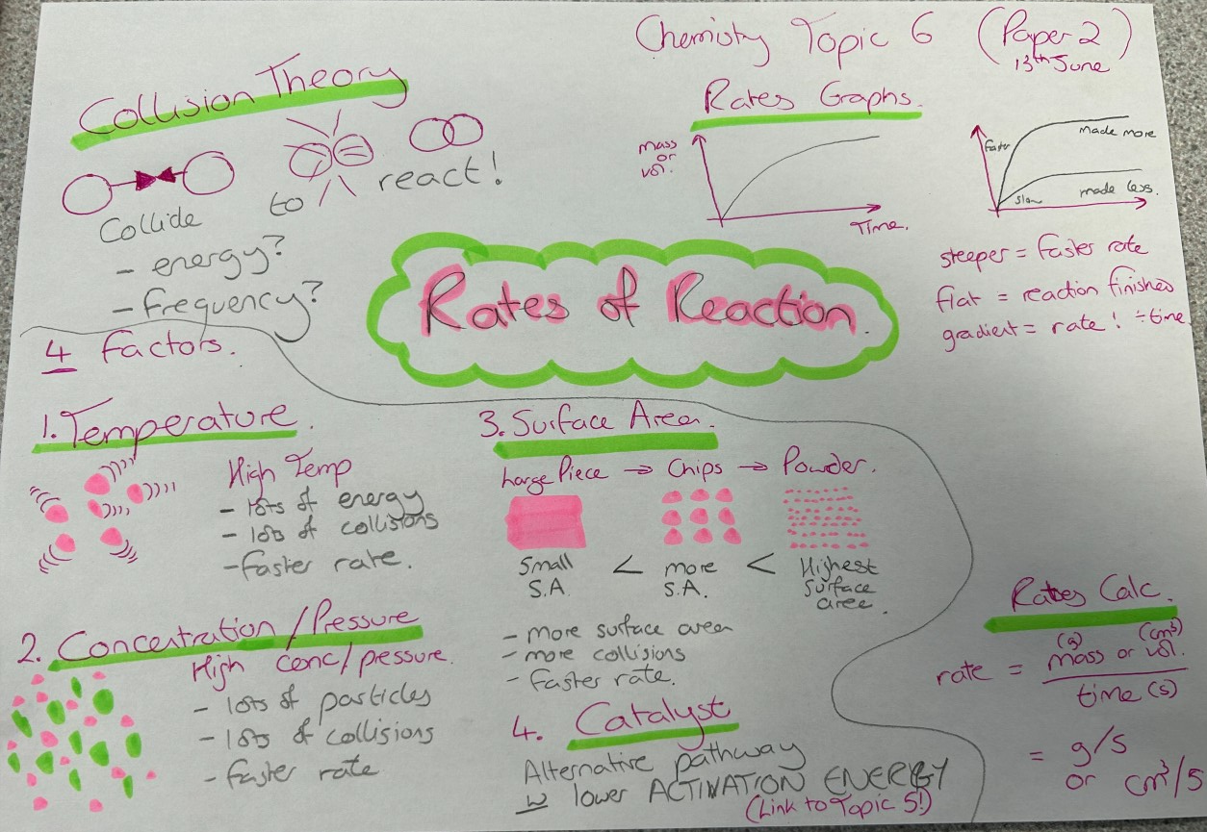
Worked Example
Step 1: collating knowledge
Dual Coding
Key terms / concepts
Label correctly

Slide 16
Worked Example
Step 2: read it back
Spaced Practice
Revisit later
Talk it through

Slide 17
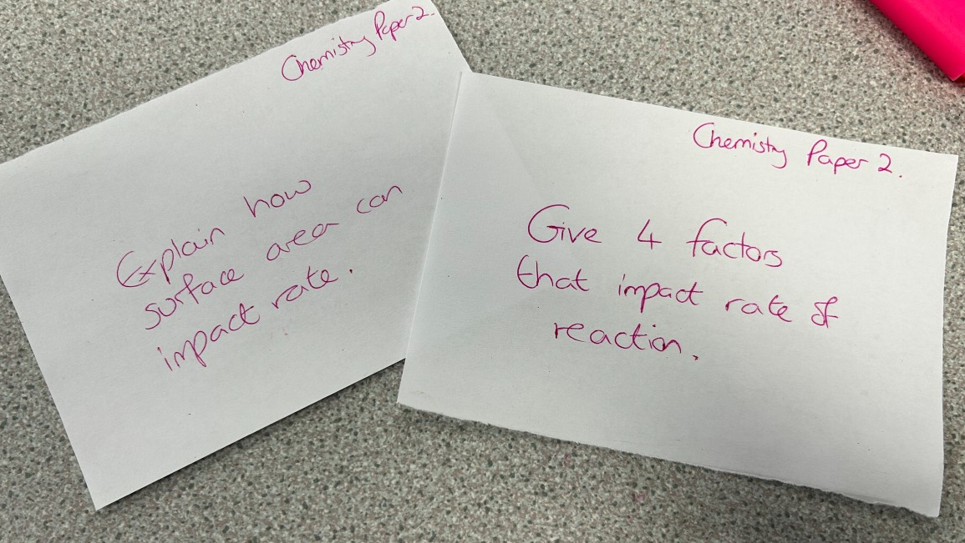
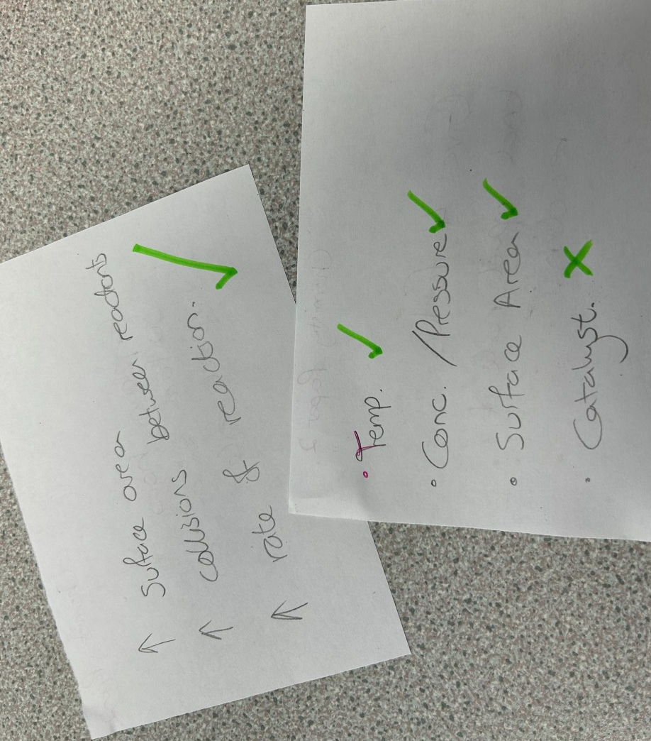
Worked Example
Step 3: practice questions
Apply the knowledge
Revisit any weak areas

Slide 18
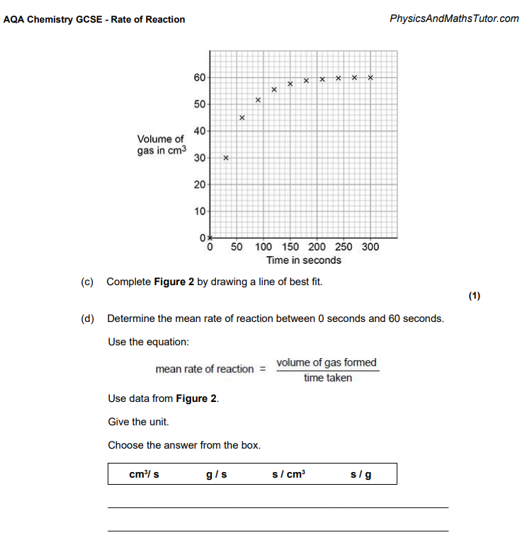
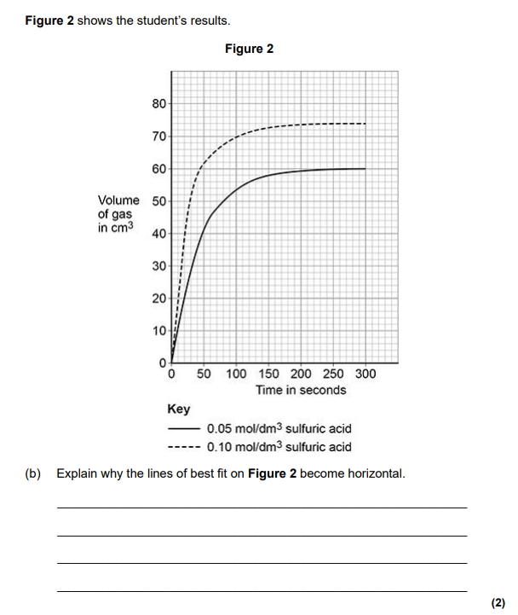
Worked Example
Step 3: practice questions
Apply the knowledge
Revisit any weak areas

Slide 19

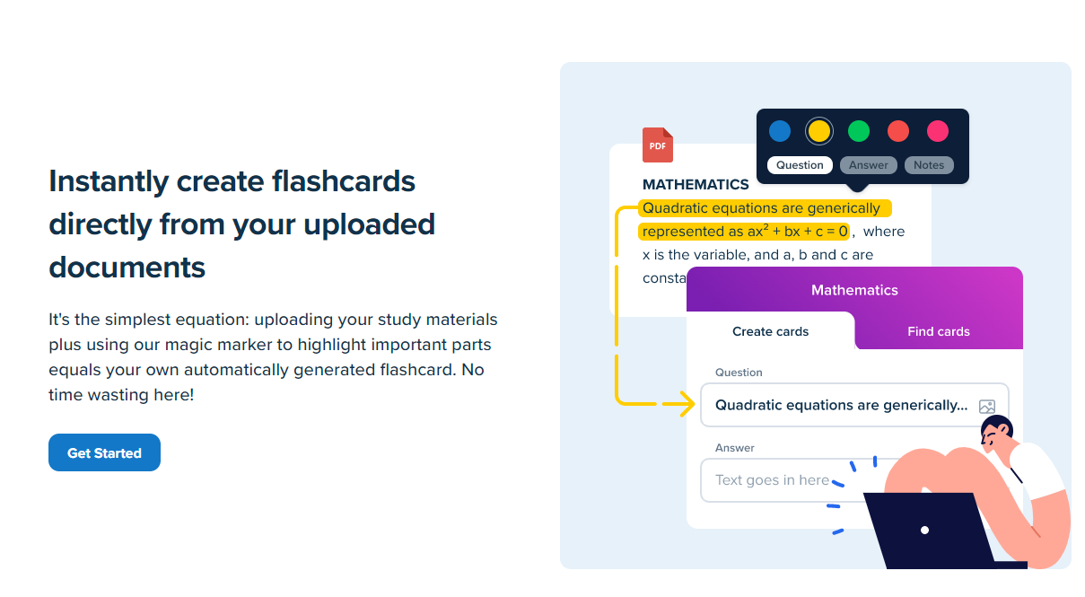
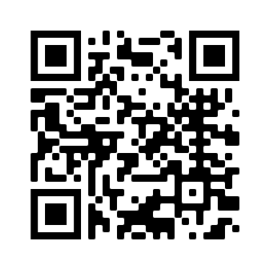
If you prefer to use apps to revise, why not try the StudySmarter app? It has thousands of flashcards already made, and if you can’t find ones which work for your subject, you can create your own.

Slide 20
Effective Study Habits
Time – Start early. You wouldn’t prepare for a dance competition an hour before. So don’t try and cram the night before.
Sleep – You brain needs sleep to recover and process the day. Lack of sleep can IMPACT memory and concentration. The two things you need.
Fresh air/Exercise – You’re not a machine. You need to move around and have some time away from revision. It also helps anxiety and allows you to think.
No phones – You owe yourself uninterrupted time away from distractions. See it as a reward for doing something that will benefit you

Slide 21
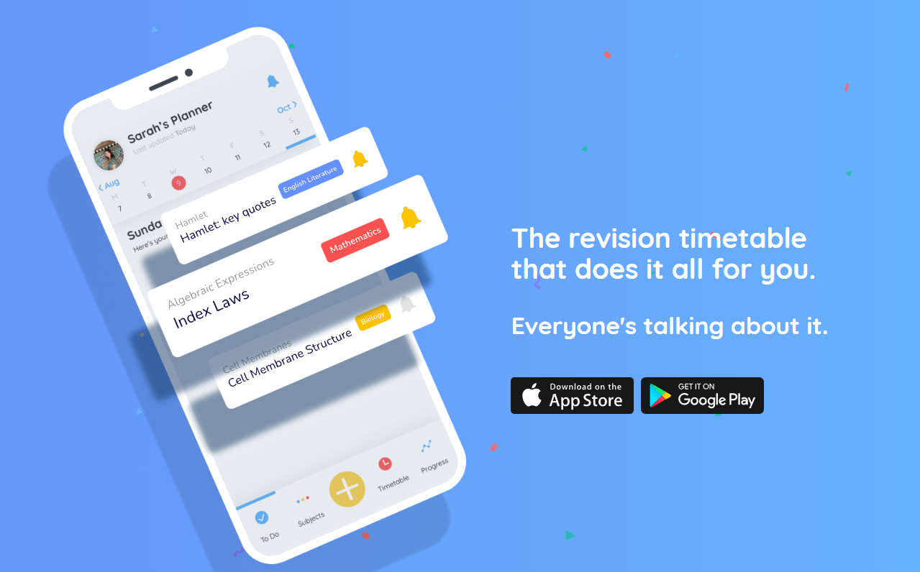
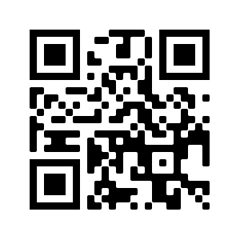
Use a revision timetable.
The ‘adapt’ app will create a bespoke revision timetable for you!

