Slide 1


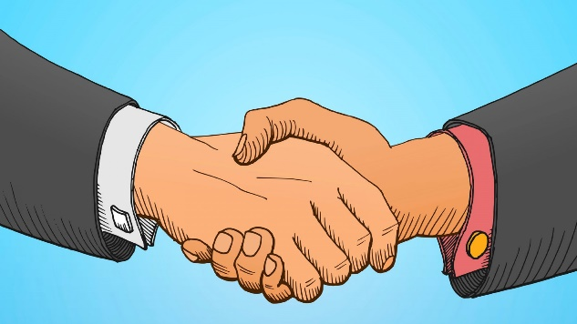
Behaviour Curriculum
Communicate
Presentation
Actions
How we speak & listen to each other
How we come across to each other
How we act towards each other

Slide 2
To learn how to give ourselves the best chance of success
June - July: Presentation
Presentation
How we come across to each other

Slide 3
Task 1
Watch the video.Heather Dorniden wins the race (HD, no cheesy music or titles) - YouTube
Answer the following two questions:
What did Heather Dorniden want to succeed at?
Make a list of all the strategies and qualities that Heather might have had that led to her success.

Slide 4
Task 2
Write down something you want to be successful at tomorrow/this year.
Make a list of all the qualities and strategies that might help you achieve that goal.
Write down something you want to be successful at in life.
Make a list of all the qualities and strategies that might help you achieve that goal.

Slide 5
The following are all strategies and qualities that have been identified as helping people achieve success:
Above all, you need to want to be successful – think about the reasons why you want to be successful. This might be because you want to show yourself and other people that you can succeed at something.

Slide 6
Be resilient. If something is difficult it is important not to give up.
Trust people that can help you be successful. Ask for help.

Slide 7
Don't let other people hold you back.
Be organised.
Be disciplined.

Slide 8
Get involved.
Think about the different opportunities that are being offered to you. Make the most of your life!

Slide 9
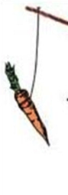
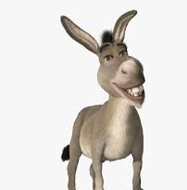
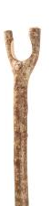
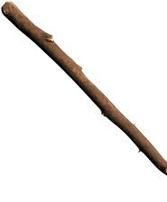

The carrot and stick theory.
Some people argue that there are two methods that can help us achieve our goals.
Think about the donkey.
I want donkey to move forward.
Donkey can be made to move forward by forcing him – using the stick.
Or getting him to move forward because he wants to and understands that there are benefits to moving forward– the carrot.
Think. Which method is the best one? Carrot or stick? What are the 'carrots' that might help you be successful?

Slide 10
Learning:
Know that you can be successful.
To be successful at something is usually difficult. That's why you have to be resilient and accept help.
Don't let other people stop you from being successful.
Make the most of your life and all the opportunities that are on offer to you.

