Slide 1


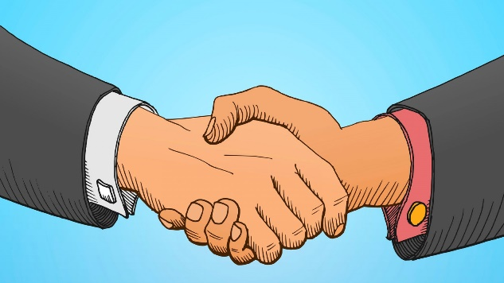
Behaviour Curriculum
Communicate
Presentation
Actions
How we speak & listen to each other
How we come across to each other
How we act towards each other

Slide 2
To learn how to manage your emotions
June - July: Communicate
Communicate
How we speak & listen to each other

Slide 3

Task 1
Definition of the word emotion: An emotion is how we feel depending on what is happening in our lives.
As you watch this video clip identify and write down three emotions that the characters show.
https://www.youtube.com/watch?v=YdcWFWm4n6g

Slide 4
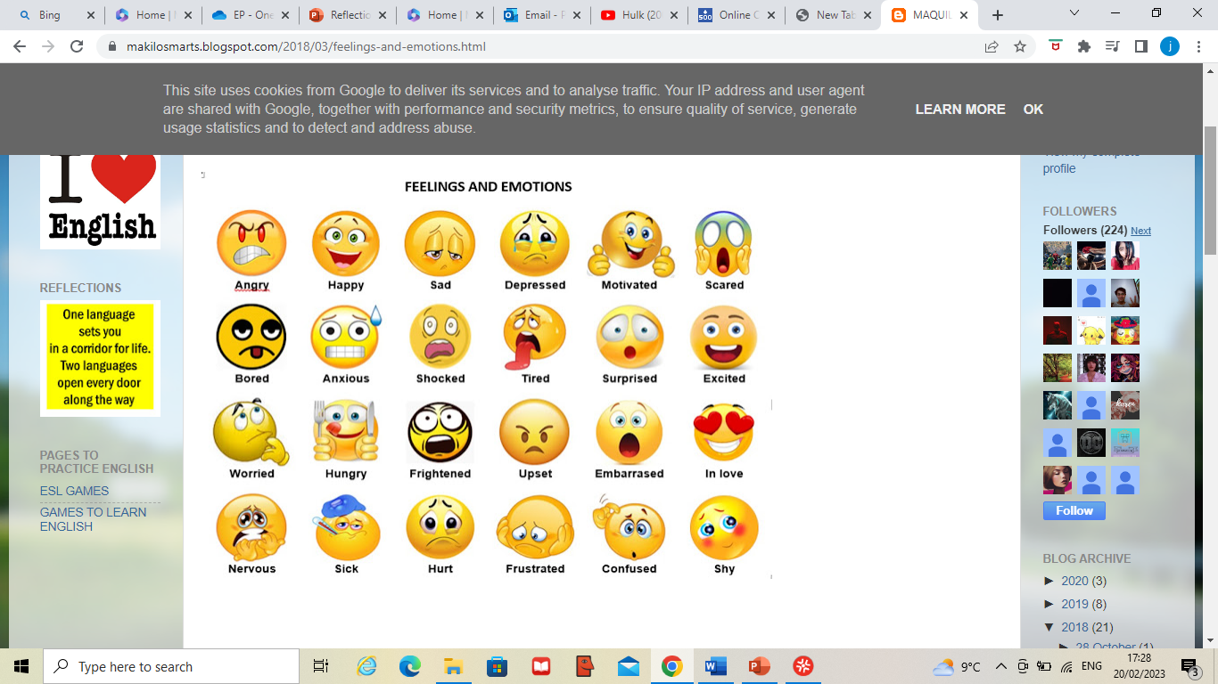
Task 2
Add as many other emotions as you can think of to your list. See if you can come up with 20. These emojis might give you some ideas.

Slide 5
Task 2
Did you get them all?
Add the ones you didn't get to your list.

Slide 6
Having emotions is good.
However sometimes the way we manage our emotions can create problems. People sometimes describe emotions that make us feel angry as a 'red mist'. When we are in a 'red mist' we might do things that lead us getting into trouble.
For example, if you are feeling angry you might want to say something horrible. Of if you are feeling confused that might make you feel embarrassed and angry and you might want to run away.

Slide 7
If you know that you react to difficult emotions in a way that gets you in trouble, it is important that you learn to use strategies to help you manage your emotions.
Some of those strategies are pre-emptive – these are things you could do before the 'red mist' comes down. These include:

Slide 8
Talking to people about how you are feeling - but at the right time and with the right people. If you are having a difficult time it is important that school knows and can provide you with the support you might need to cope with difficult emotions.

Slide 9
Exercise. This is one of the most common ways used by people to cope with all sorts of emotions.

Slide 10
Art. Some people find that they can't talk to people about how they feel but they feel better for expressing their emotions through drawing or painting.

Slide 11
Make sure you are prepared with some strategies that you can use if you are starting to feel that your emotions are getting out of control. These might include:
Using a stress ball
Stepping out of the situation for a few minutes
Grounding exercises – these are activities designed to get your brain to calm down and include things like thinking of 5 blue things, 4 red things, 3 yellow things, 2 orange things and 1 purple thing. Or thinking of football teams starting with the letter A, B and so on.
There might be other strategies that you have found that have worked for you.

Slide 12
Task 3
As a class complete the table on the following slide.

Slide 13
Scenario | What emotions might this cause? | How might you react that might lead you to get into trouble? | What would be the best way to react to stop you getting into trouble?
The work you have been given in class is difficult to understand
You have been told off for something that you didn't do
You find out that someone has been talking about you behind your back

Slide 14
Learning:
It is okay to feel the way you that feel
But you must not let your emotions make choices for you.
By understanding your emotions you can make better choices
Try using different strategies to help you cope better with difficult emotions.

