Slide 1


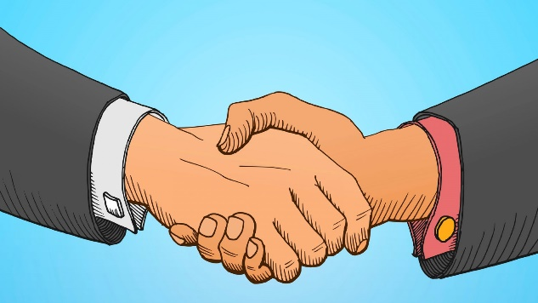
Behaviour Curriculum
Communicate
Presentation
Actions
How we speak & listen to each other
How we come across to each other
How we act towards each other

Slide 2
To be able to identify when your actions may lead to a negative response.
June - July: Presentation
Presentation
How we come across to each other

Slide 3
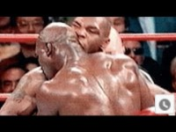
Task 1
Watch the video.
Answer the following three questions:
What did Mike do?
Why did he do this?
What response do you think this had?

Slide 4

Task 1
Answer the following two questions:
What did Tyson do in this clip?
What did you think when you saw this?
How do you think people responded to seeing this?
Now watch this video.

Slide 5
Task 1
Mike Tyson was losing his fight to Evander in the 1st video, he chose to bite Evander's ear in frustration as he could not see a way out.
People saw this and had an widespread negative response – he was no longer a world champion but a sore loser who could not take losing as well as winning.
Tyson Fury was also (seconds away from!) losing in the second video, instead he chose to stand up again and fight his way to the end – regardless of the outcome.
The match was a draw but the public were completely focused on how he regained his composure and soldiered on – an overwhelmingly positive response.

Slide 6
Task 2
Write down something you have done in the past that has received a negative response (could be from friends, teachers, family etc.)
Why do you think they responded this way?
Write down what you could have done differently to get a better response.

Slide 7
The decisions you make can often have an effect on those around you, these may be people who care about you and only want to support you in becoming the best that you can be.
The points below will hopefully help with deciding on how best to act before you do:
Why do I want to do this?
What benefit will it have for me?
Who will it affect?
How will they react?
How do I want these people to react?
Finally – Should I do it?
If the answers to the questions above are positive then do it! If not think what might be a better option.

Slide 8
Learning:
Think before you act
Will you actions help you moving forwards
How will your actions be perceived by others?
Does this make you feel good/bad?
Should you do it?

