Slide 1
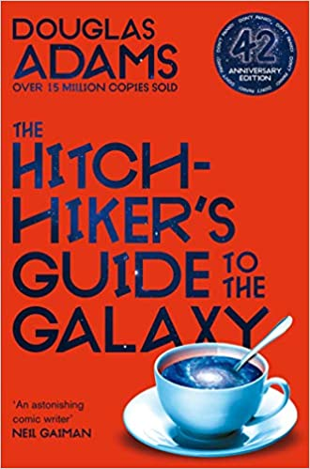
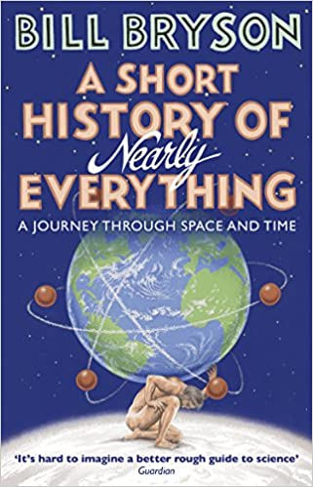
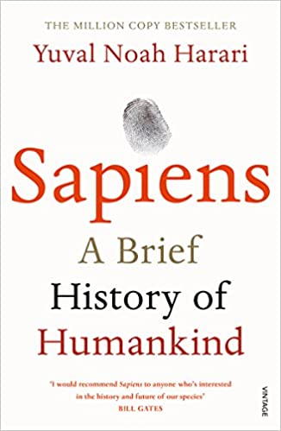
Science
Recommended Reading
Hitch-Hikers Guide to the Galaxy
It's an ordinary Thursday lunchtime for Arthur Dent until his house gets demolished. The Earth follows shortly afterwards to make way for a new hyperspace express route, and his best friend has just announced that he's an alien. At this moment, they're hurtling through space with nothing but their towels and an innocuous-looking book inscribed, in large friendly letters, with the words: DON'T PANIC. The weekend has only just begun . . .
RRP £6.99
A Short History of Everything
Bill Bryson's challenge is to take subjects that normally bore the pants off most of us, like geology, chemistry and particle physics, and see if there isn't some way to render them comprehensible to people who have never thought they could be interested in science. As a result, A Short History of Nearly Everything reveals the world in a way most of us have never seen it before.
RRP £9.25
Sapiens
Sapiens, the book, takes us on a breath-taking ride through our entire human history, from its evolutionary roots to the age of capitalism and genetic engineering, to uncover why we are the way we are. Sapiens focuses on key processes that shaped humankind and the world around it, such as the advent of agriculture, the creation of money, the spread of religion and the rise of the nation state.
RRP £9.25

