Slide 1

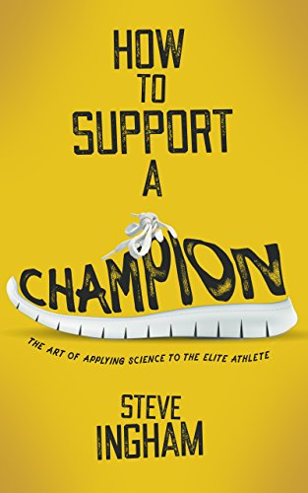
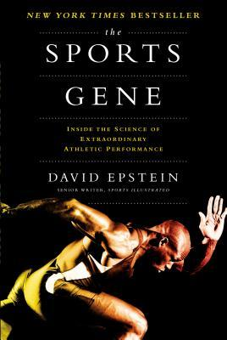
P.E.
Recommended Reading
Book cover
KS3
You are a champion
In You Are a Champion: Unlock Your Potential, Find Your Voice and Be the BEST You Can Be, Marcus Rashford MBE draws on stories from his own life to show you that success is all about the mindset. You’ll find out how positive thinking can change your life, build mental resilience, learn how to navigate adversity and discover the unstoppable power of your own voice. You already have the tools you need to achieve your dreams; you just might not know it yet.
RRP £8.49
Book cover
KS4
How to support a Champion
If you are contemplating working with a champion, a potential champion, or anyone with untapped talent - be prepared, be very prepared. In 1998 Sir Steve Redgrave stared at Ingham and demanded to know, “Are you going to make me go faster?” Ingham had been trained and developed as a scientist, but in that single instance he questioned everything he thought he knew. Applied science in elite sport has boomed. Science has radically changed elite sport, but one thing remains as the guiding focus - the summit of performing to your best and winning. This applies to the athlete, the coaches and increasingly for the applied practitioner. In this book Ingham draws on the lessons learned from a career in the intense, unforgiving rollercoaster of elite sport; helping, supporting and developing some of the best athletes in the world, including Sir Steve Redgrave, Sir Matthew Pinsent, Hayley Tullett, Kelly Sotherton, and Jessica Ennis-Hill as they pursue their goals. His journey shows that all the knowledge in the world will get you only so far, but it is with trust, team-work, critical thinking, adaptability, accountability and altruism that you can truly support a champion.
RRP £7.51
Book cover
KS5
Sports gene
This book is an exploration of many of the factors that influence the performance of top-flight athletes. The book starts out with a fascinating, attention-getting description of a challenge softball game. A pro softball team challenges a pro baseball team to a softball game. The young woman softball pitcher approaches the pitcher's mound, and her entire team sits down on the field! They realize that there is no possibility for any of the baseball tam to hit the ball! And they are absolutely right--the opposing team never makes a hit! David Epstein explains why this happened, but while exceedingly impressive, the reason has absolutely nothing to do with genetics. It has to do with training, and the subconscious cues that ball players learn with lots of practice.
RRP £10.99

