Slide 1
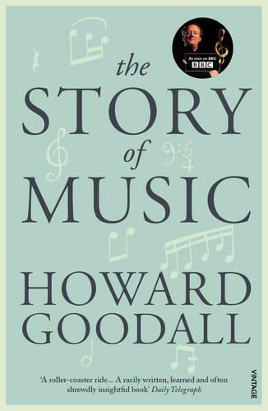
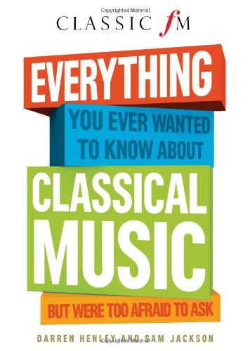
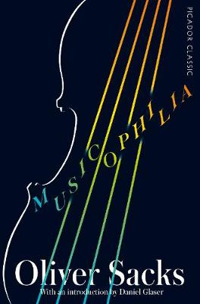
Music
Recommended Reading
The Story of Music – Howard Goodall
Howard Goodall leads us through the story of music as it happened, idea by idea, so that each musical innovation - the orchestra, dance music, recording, broadcasting - strikes us with its original force. He focuses on what changed when and why. Along the way, he also gives refreshingly clear descriptions of what music is and how it works: what scales are all about and what all post-war pop songs have in common.
RRP £12.99
Book cover
KS4
The Classic FM Handy Guide to Everything You Ever Wanted to Know About Classical Music
Trace the history of classical music from its birth through the Baroque, Classical and Romantic periods and right up to the present day. Packed full of essential information, this book explores the lives and works of the key composers from around the world. Classic FM's Handy Guides are a fun and informative set of introductions to standout subjects within classical music.
RRP £11.99
Book cover
KS5
Musicophilia: Tales of Music and the Brain
Dr Oliver Sacks examines the power of music through the individual experiences of patients, musicians, and everyday people. Among them: a surgeon who is struck by lightning and suddenly becomes obsessed with Chopin; and a man whose memory spans only seven seconds - for everything but music. Dr Sacks describes how music can animate people with Parkinson's disease who cannot otherwise move, give words to stroke patients who cannot otherwise speak, and calm and organize people who are deeply disoriented by Alzheimer's or schizophrenia.
RRP £12.99

