Slide 1
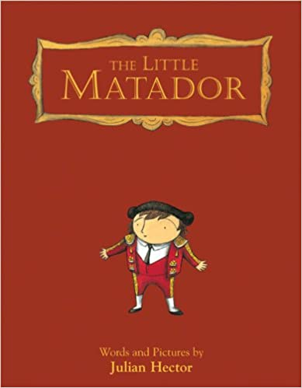
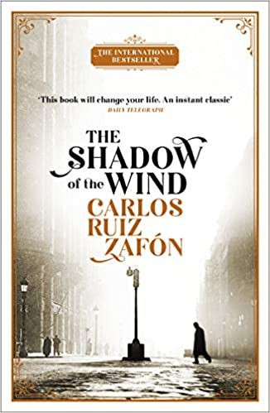
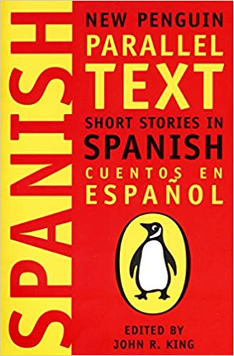
Modern Foreign Language- Spanish
Recommended Reading
The Little Matador
If you’re looking for children’s books about Spain, then be sure to check out The Little Matador by Julian Hector. This book is only about 40 pages and was published in 2008 as a children’s picture book. Throughout the book, the reader follows the Little Matador, who is from a family where everyone becomes a bullfighter, but he doesn’t want to. He ends up falling in love with art and drawing instead and tries to use his talents in other ways.
RRP £ 4.99
The Shadow of the Wind
The Shadow of the Wind is arguably one of the best historical fiction about Spain that you won’t want to miss. Ruiz Zafon has published many historical fiction novels about the country, so if you enjoy this one, be sure to check out his other works. This novel about Barcelona takes place in 1945, right after the war. It follows Daniel, who is grieving his mother’s death when he finds The Shadow of the Wind, a book by Julian Carax. However, he soon finds out that someone is destroying all of Carax’s books for some reason, and he soon gets entwined in an exciting mystery.
RRP £ 5.99
Spanish Short Stories: Cuentos En Espanol
This collection of eight short stories includes translations into English to help you improve and develop your vocabulary, language structure and comprehension. Accessible and entertaining, a must for further reading in this subject.
RRP £7.95

