Slide 1
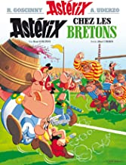


Modern Foreign Language- French
Recommended Reading
Astérix: chez les Bretons
Join Astérix and his friends on an adventure containing classic French comedy in comic strip form. Some excellent drawings to help you understand the language and immerse yourself in a piece of French culture.
RRP £ 12.50
Le Petit Prince
The story follows a young prince who visits various planets in space, including Earth, and addresses' themes of loneliness, friendship, love, and loss. Despite its style as a children's book, The Little Prince makes observations about life, adults and human nature
RRP £ 11.99
Charlotte
This novel is based on a true story, the one of Charlotte Solomon, a German-Jewish artist born in Berlin in 1917 who died at 26, when she was pregnant. The novel sees the expansion of Nazi Germany. However, the take is decidedly intimate and the focus in on Charlotte’s life, her loves and her family. The novel is both beautifully touching and terribly heart-breaking
RRP £ 9.99

