Slide 1
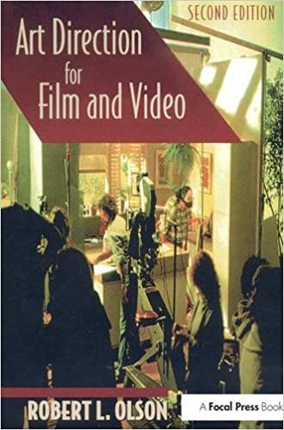
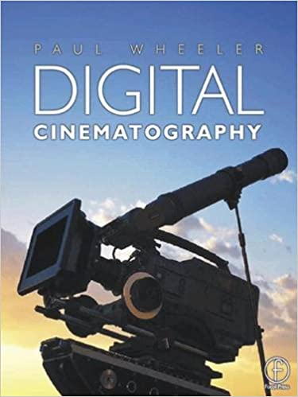
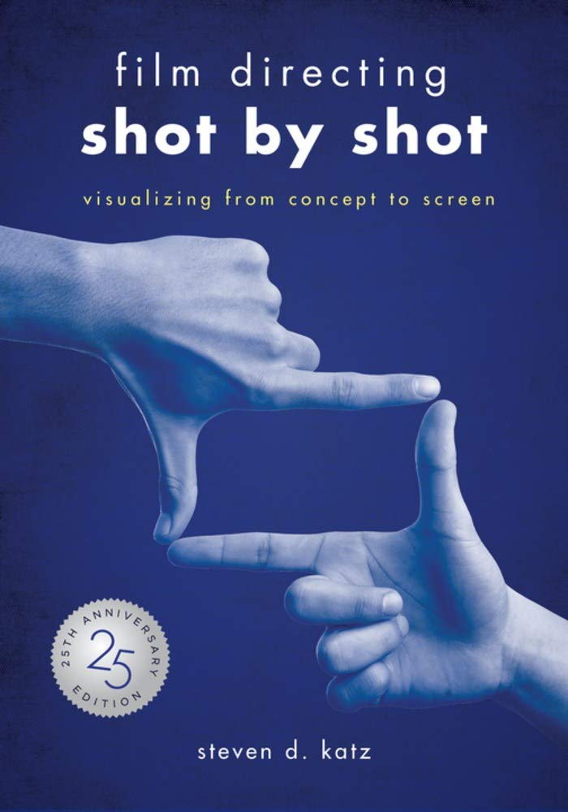
Media
Recommended Reading
Art Direction for Film and Video
This book takes a practical, thorough look at the duties and skills of art directors and production designers. It teaches readers how to analyze a script, develop concepts that meet the needs of a script, develop sketches and construction drawings, work with directors and producers, and operate within budget limitations. Students, novices in the profession, and persons from other art/design fields who are interested in expanding into film and video will find this is a valuable resource.
RRP £44.99
Digital Cinematography
This book covers the `on-the-set' knowledge you need to know - its emphasis lies in practical application, rather than descriptions of technologies, so that in this book you will find usable `tools' and information to help you get the job done. From `getting the look' to lighting styles and ratios, what is needed for different types of shoots and the technical preparation required, this is a complete reference to the knowledge and skills required to shoot high end digital films.
RRP £35.99
Film Directing Shot by Shot
The book contains over 800 photos and illustrations, and is by far the most comprehensive look at shot design in print, containing storyboards from movies such as Citizen Kane, Blade Runner, Dead-pool, and Moonrise Kingdom. Also introduced is the concept of A, I, and L patterns as a way to simplify the hundreds of staging choices facing a director in every scene. Shot by Shot uniquely blends story analysis with compositional strategies, citing examples then il-lustrated with the storyboards used for the actual films. Throughout the book, various visual approaches to short scenes are shown, exposing the directing processes of our most celebrated auteurs
RRP £25.26

