Slide 1
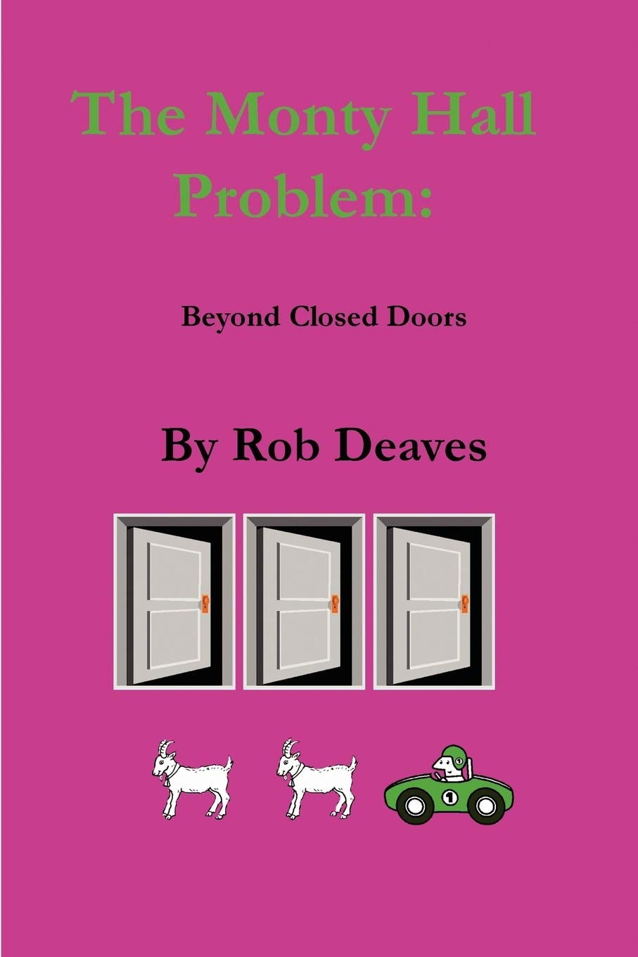
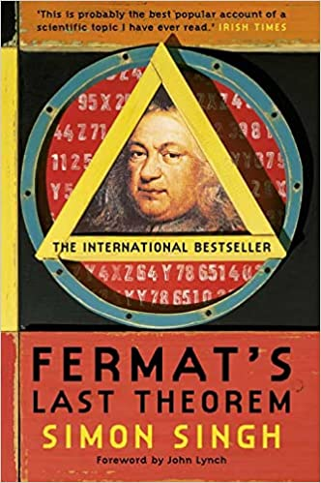
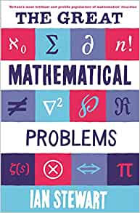
Maths
Recommended Reading
Book cover
KS3
The Monty Hall Problem: Beyond Closed Doors by Rob Deaves
This short book explores the Monty Hall dilemma, a well known mathematical puzzle. The original problem, the controversy surrounding it and its solution are discussed. Further, the boundaries of the problem are expanded to consider prior knowledge and host intention. This book should be of interest to those who enjoy problem solving.
RRP £6.99
Book cover
KS4
Fermat's Last Theorem by Simon Singh
The story of the solving of a puzzle that has confounded mathematicians since the 17th century. In 1963, a schoolboy browsing in his local library stumbled across the world's greatest mathematical problem: Fermat's Last Theorem, a puzzle that every child can understand but which has baffled mathematicians for over 300 years. Aged just ten, Andrew Wiles dreamed that he would crack it. Wiles's lifelong obsession with a seemingly simple challenge set by a long-dead Frenchman is an emotional tale of sacrifice and extraordinary determination. In the end,
RRP £8.99
Book cover
KS5
The Great Mathematical Problems by Ian Stewart
There are some mathematical problems whose significance goes beyond the ordinary - like Fermat's Last Theorem or Goldbach's Conjecture - they are the enigmas which define mathematics. This book explains why these problems exist, why they matter, what drives mathematicians to incredible lengths to solve them and where they stand in the context of mathematics and science as a whole.
RRP £6.99

