Slide 1
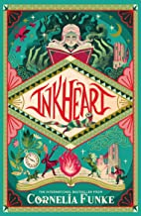
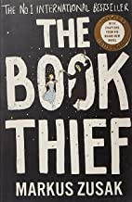
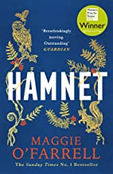
English Literature
Recommended Reading
Inkheart, Cornelia Funke
One cruel night, Meggie's father reads aloud from a book called INKHEART-- and an evil ruler escapes the boundaries of fiction and lands in their living room. Suddenly, Meggie is smack in the middle of the kind of adventure she has only read about in books. Meggie must learn to harness the magic that has conjured this nightmare. For only she can change the course of the story that has changed her life forever. This is INKHEART--a timeless tale about books, about imagination, about life. Dare to read it aloud.
RRP £7.99
The Book Thief, Marcus Zusak
It is 1939. Nazi Germany. The country is holding its breath. Death has never been busier, and will be busier still. By her brother's graveside, Liesel's life is changed when she picks up a single object, partially hidden in the snow. It is The Gravedigger's Handbook, left behind there by accident, and it is her first act of book thievery. So begins a love affair with books and words, as Liesel, with the help of her accordian-playing foster father, learns to read. Soon she is stealing books from Nazi book-burnings, the mayor's wife's library, wherever there are books to be found. But these are dangerous times. When Liesel's foster family hides a Jew in their basement, Liesel's world is both opened up, and closed down.
RRP £8.99
Hamnet, Maggie O'Farrell
Drawing on Maggie O'Farrell's long-term fascination with the little-known story behind Shakespeare's most enigmatic play, HAMNET is a luminous portrait of a marriage, at its heart the loss of a beloved child. Warwickshire in the 1580s. Agnes is a woman as feared as she is sought after for her unusual gifts. She settles with her husband in Henley street, Stratford, and has three children: a daughter, Susanna, and then twins, Hamnet and Judith. The boy, Hamnet, dies in 1596, aged eleven. Four years or so later, the husband writes a play called Hamlet.
RRP £8.99

