Slide 1
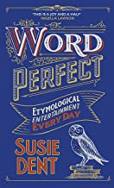
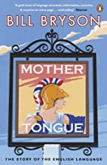
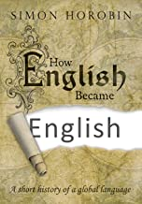
English Language
Recommended Reading
Word Perfect, Susie Dent
Welcome to a year of wonder through the English language with Susie Dent, lexicographer extraordinaire and queen of Countdown's Dictionary Corner. From 'Turning a Blind Eye' (Nelson putting the telescope to his missing eye to ignore the order to stop fighting) to why May Day became a distress call; from stealing someone's thunder to the real Jack the Lad, from tartle (forgetting someone's name) to snaccident (unintentionally eating a whole packet of biscuits), Word Perfect is her brilliant linguistic almanac full of unforgettable true stories tied to every day of the year. You'll never be lost for words again
RRP £7.99
Mother Tongue, Bill Bryson
With dazzling wit and astonishing insight, Bill Bryson—the acclaimed author of The Lost Continent—brilliantly explores the remarkable history, eccentricities, resilience and sheer fun of the English language. From the first descent of the larynx into the throat (why you can talk but your dog can't), to the fine lost art of swearing, Bryson tells the fascinating, often uproarious story of an inadequate, second-rate tongue of peasants that developed into one of the world's largest growth industries.
RRP £9.99
How English Became English, Simon Horobin
The English Language is spoken by more than a billion people throughout the world. But where did English come from? And how has it evolved into the language used today? In Do You Speak English? Simon Horobin investigates the evolution of the English language, examining how the language continues to adapt even today, as English continues to find new speakers and new uses. Engaging with contemporary concerns about correctness, Horobin considers whether such changes are improvements, or evidence of slipping standards. What is the future for the English Language? Will Standard English continue to hold sway, or are we witnessing its replacement by newly emerging Englishes?
RRP £10.99

