Slide 1
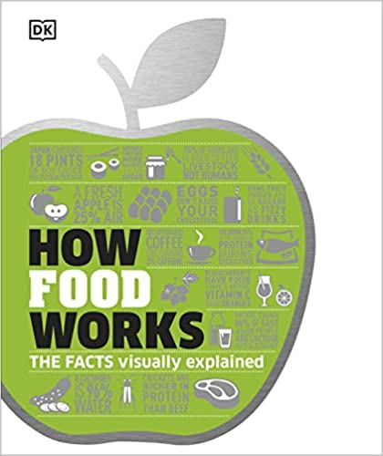
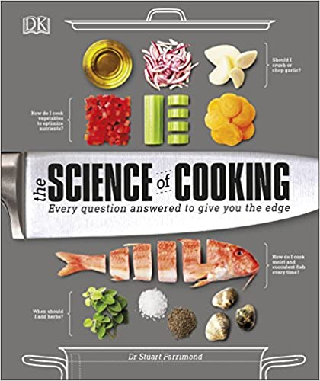
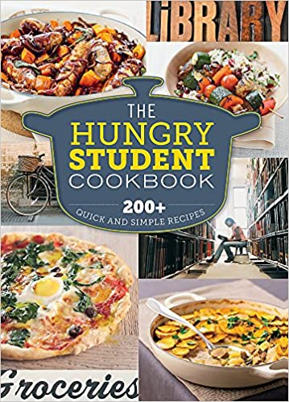
Design & Technology
Recommended Reading
Book cover
KS3
How Food Works: The Facts Visually Explained (How Things Work)
Discover nutritional facts about the food you eat, learn the benefits of superfoods and antioxidants, and go behind-the-scenes of modern food production. Packed with infographics and colourful images, the book delves into the science behind ways of eating including gluten-free and veganism, as well as the benefits of different diets from around the world. This book shows there more to food than just cooking!
RRP £14.30
Book cover
KS4
The Science of Cooking: Every Question Answered to Perfect your Cooking
Which vegetables should you eat raw? How do you make the perfect poached egg? And should you keep your eggs in the fridge? Food scientist Dr Stuart Farrimond answers all these questions - and many more like them - equipping you with the scientific know-how to take your cooking to new levels.
RRP £14.99
Book cover
KS5
The Hungry Student Cookbook
Each recipe has a cost breakdown to help with budgeting and detailed instructions to make them accessible to even the most novice cook. While Eat Healthy contains full nutritional information to prep your body and brain for intensive studying! The perfect book to practice your cooking skills before heading off to University.
RRP £8.19

