Slide 1
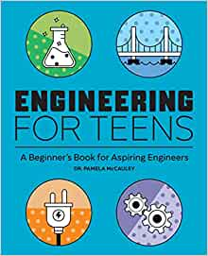
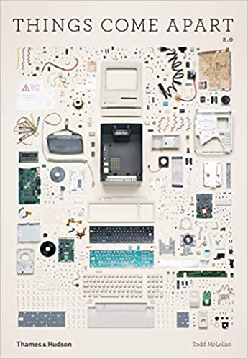
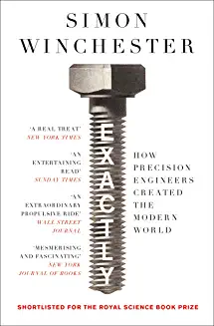
Design & Technology
Recommended Reading
Book cover
KS3
Engineering for Teens: A Beginner's Book for Aspiring Engineers
The job of an engineer is to solve all sorts of complex challenges facing the world while improving our lives through creative, innovative ideas. This engineering book for teens gives you a look into what engineers do and how they drive society forward through math and science. From designing tablets and smartphones to reimagining the way we collect and store renewable energy, this engineering book gives an introduction to future careers in engineering and design.
RRP £10.20
Book cover
KS4
Things Come Apart 2.0: A Teardown Manual for Modern Living
Ever wondered what everyday objects looked like when taken apart? This book has a collection of objects which have been disassembled to show how many parts and components go into making products you will be familiar with. Things Come Apart conjures the childlike joy of taking something apart to see how it works, and will appeal to anyone with a curiosity about the material world.
RRP £10.99
Book cover
KS5
Exactly: How precision engineers created the modern world
Precision is the key to everything. It is an integral, unchallenged and essential component of our modern social, scientific, mechanical and intellectual landscapes. The items we value in our daily lives – a camera, phone, computer, bicycle, car, a dishwasher perhaps – all sport components that fit together with precision and operate with near perfection. We also assume that the more precise a device the better it is. The author explores how precision and accuracy affects product design.
RRP £9.99

