Slide 1
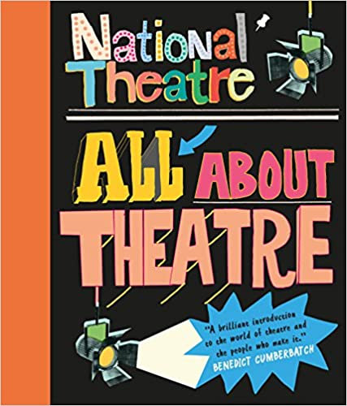
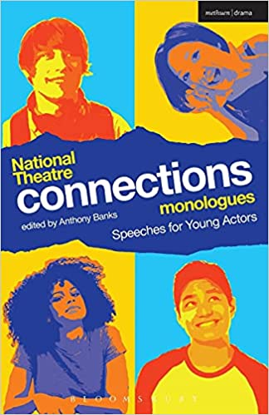
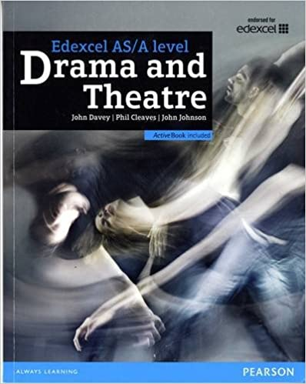
Drama
Recommended Reading
Book cover
KS3
All About Theatre
Described by Benedict Cumberbatch as "a brilliant introduction to theatre", this fascinating book by the National Theatre shows how plays like War Horse and many others are made. The book is packed with interviews with famous directors and actors, like Lenny Henry, Meera Syal, Julie Walters and Ben Whishaw, and productions like The Curious Incident of the Dog in the Night-Time and One Man, Two Guvnors. Hear from experts at the world-famous National Theatre about every aspect of stagecraft, including prop-making, set building and lighting design, and discover, from first idea to final curtain, how plays are made.
RRP £9.99
Book cover
KS4
National Theatre Connections Monologues: Speeches for Young Actors
This anthology of 100 monologues is the ideal resource for teenagers and young people attending auditions either in the amateur or professional theatre world; students leaving secondary school to audition for drama school; as well as teachers of English and Drama looking for suitable dramatic for their students to engage with and perform. It provides suitable scene-study books that are suitable and relevant to the student in terms of tone, style and content. Young actors who have searched for audition material written in the voice of teenage characters will welcome this resource.
RRP £16.38
Book cover
KS5
Edexcel A level Drama and Theatre Student Book
The Edexcel AS and A Level Drama and Theatre Student Book focuses on supporting students throughout the course in developing the skills they need for the exam component, Theatre Makers in Practice.
RRP £24.15

