Slide 1
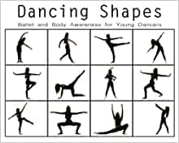
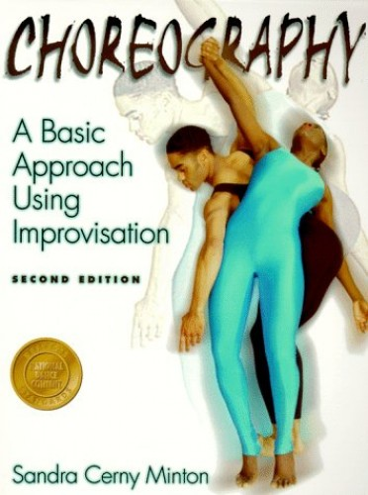
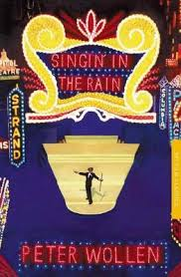
Dance
Recommended Reading
Book cover
KS3
Dancing Shapes: Ballet and Body Awareness for Youung Dancers (Dancing Shapes Series)
Dancing Shapes provides an inside gorgeous glimpse into one ballerina’s journey. Konora, whose career has been sidelined by COVID-19, leads readers through warm-up steps, a basic ballet technique lesson, and an exploration of movement and form. With more than fifty poses to contemplate or re-create, aspiring young dancers: learn basic vocabulary, increase body awareness and celebrate making healthy choices
RRP £6.00
Book cover
KS4
Choreography – A Basic Approach Using Imporvisation
Whatever your dance background or choreographic interest, this book shows you how to solve common choreography problems, design and shape movements into a dance, organize a dance concert, and observe a finished dance. The book features 63 movement exploration exercises and takes you from dance making to preparing for a performance. More than 56 photographs highlight and clarify important concepts.
RRP £14.99
Book cover
KS5
Singin’ in The Rain
Sixty years after its release, Singin' in the Rain (1952) remains one of the best loved films ever made. Yet despite dazzling success with the public, it never received its fair share of critical analysis. Gene Kelly's genius as a performer is undeniable. Acknowledged less often is his innovatory contribution as director. Peter Wollen's illuminating study of Singin' in the Rain does justice to this complex film. In a brilliant shot-by-shot analysis of the famous title number,
RRP £12.99

