Slide 1
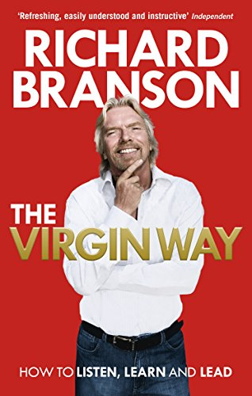
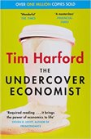
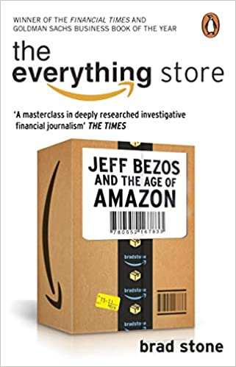
Business and Economics
Recommended Reading
Book cover
KS3
The Virgin Way: How to Listen, Learn, Laugh and Lead
With over 40 years in business, Richard Branson is an inspiring pioneer of humanitarian projects and an iconic business leader. In The Virgin Way: How to Listen, Learn, Laugh and Lead, Richard shares and distils his secrets of leadership and success. Featuring anecdotes from his own business dealings, as well as his observations of many others who have inspired him – from politicians, business leaders, explorers, scientists and philanthropists – Richard reflects on the qualities he feels are essential for success in today’s world.
RRP £7.48
Book cover
KS4
The undercover economist
Who makes most money from the demand for cappuccinos early in the morning at Waterloo Station? Why is it impossible to get a foot on the property ladder? How does the Mafia make money from laundries when street gangs pushing drugs don't? Who really benefits from immigration? How can China, in just fifty years, go from the world's worst famine to one of the greatest economic revolutions of all time, lifting a million people out of poverty a month?
RRP £6.25
Book cover
KS5
The Everything Store: Jeff Bezos and the Age of Amazon
Though Amazon.com started off delivering books through the mail, its visionary founder, Jeff Bezos, was never content with being just a bookseller. He wanted Amazon to become 'the everything store', offering limitless selection and seductive convenience at disruptively low prices. To achieve that end, he developed a corporate culture of relentless ambition and secrecy that's never been cracked. Until now...
RRP £9.25

