Slide 1
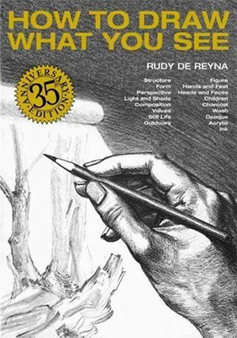
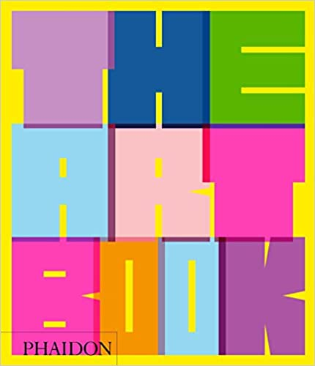
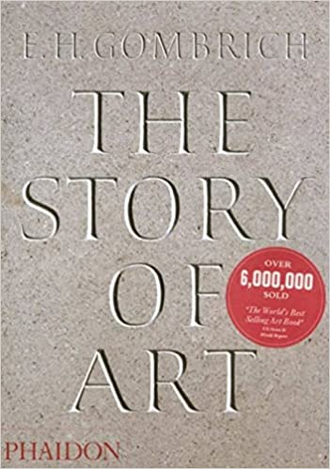
Art
Recommended Reading
Book cover
KS3
How to Draw What you See
This is a timeless classic that has taught generations of artists. "I believe that you must be able to draw things as you see them - realistically," wrote Rudy de Reyna in his introduction. "How to Draw What You See" shows artists how to recognize the basic shape of an object - cube, cylinder, cone, or sphere - and use that shape to draw the object, no matter how much detail it contains.
RRP £
RRP £11.99
Book cover
KS4
The Art Book
Breaking with traditional classifications, The Art Book is organised by artist name, throwing together brilliant examples from all periods, schools, visions, and techniques in a vibrant A-Z sequence to create an unparalleled visual sourcebook and a celebration of our rich, multifaceted culture.
RRP £29.95
Book cover
KS5
The Story of Art
The Story of Art, one of the most famous and popular books on art ever written, has been a world bestseller for over four decades. Attracted by the simplicity and clarity of his writing, readers of all ages and backgrounds have found in Professor Gombrich a true master, and one who combines knowledge and wisdom with a unique gift for communicating his deep love of the subject.
RRP £29.95

