Slide 1
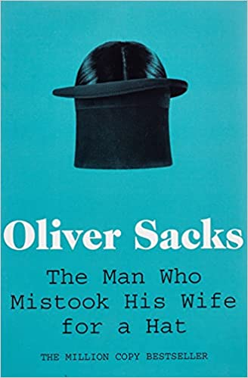
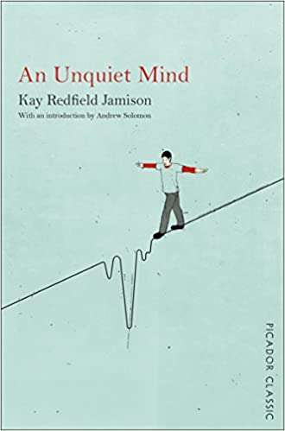
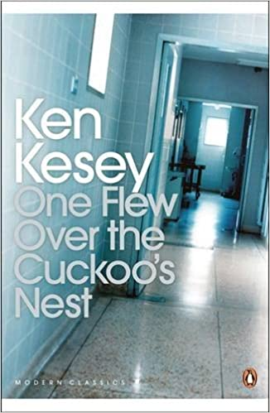
Psychology
Recommended Reading
Book cover
The Man Who Mistook His Wife for a Hat
These are case studies of people who have lost their memories and with them the greater part of their pasts; who are no longer able to recognize people or common objects; whose limbs have become alien; who are afflicted and yet are gifted with uncanny artistic or mathematical talents. In Dr Sacks’s splendid and sympathetic telling, each tale is a unique and deeply human study of life struggling against incredible adversity. ‘Oliver Sacks has become the world’s best-known neurologist. His case studies of broken minds offer brilliant insight into the mysteries of consciousness’ – Guardian
RRP £6.99
Book cover
An Unquiet Mind: A Memoir of Moods and Madness
Dr Kay Redfield Jamison is one of the foremost authorities on manic depression (bipolar disorder) - and has experienced its terrors and cruel allure first-hand. While pursuing her career in medicine, she was affected by the same exhilarating highs and catastrophic lows that afflicted many of her patients. From her jubilant childhood to the disquiet that has dominated her adult life, she charts a journey through her own mind, and those of others.
RRP £7.63
One Flew Over the Cuckoo's Nest
Tyrannical Nurse Ratched rules her ward in an Oregon State mental hospital with a strict and unbending routine, unopposed by her patients, who remain cowed by mind-numbing medication and the threat of electric shock therapy. But her regime is disrupted by the arrival of McMurphy – the swaggering, fun-loving trickster with a devilish grin who resolves to oppose her rules on behalf of his fellow inmates. His struggle is seen through the eyes of Chief Bromden, a seemingly mute half-Indian patient who understands McMurphy's heroic attempt to do battle with the powers that keep them imprisoned. Ken Kesey's extraordinary first novel is an exuberant, ribald and devastatingly honest portrayal of the boundaries between sanity and madness.
RRP £7.95
Book cover

