Slide 1
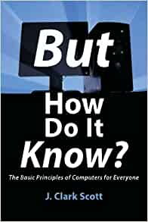
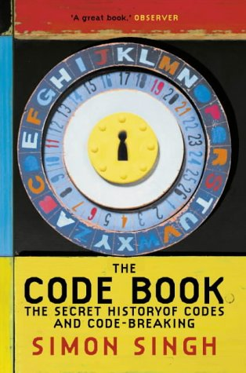
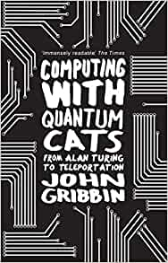
IT and Computing
Recommended Reading
Book cover
KS3
But how do it know?
This book thoroughly demonstrates each of the basic principles that have been used in every computer ever built, while at the same time showing the integral role that codes play in everything that computers are able to do. It cuts through all of the electronics and mathematics, and gets right to practical matters. Here is a simple part, see what it does. Connect a few of these together and you get a new part that does another simple thing. After just a few iterations of connecting up simple parts - voilà! - it's a computer. And it is much simpler than anyone ever imagined.
RRP £11.99
Book cover
KS4
The Code Book: The secret History of codes and code breaking
The Code Book contains many fascinating accounts of code-breaking in action, from its use in unmasking the Man in the Iron Mask and the defeat of the Nazis to the breaking of a modern cipher system by a world-wide army of amateurs in 1994. It is especially good on the most recent developments, such as quantum cryptology and the thorny civil liberties issues raised by the advent of very secure cipher systems over the Internet
RRP £9.34
Book cover
KS5
Computing with Quantum Cats: From Alan Turing to Teleportation: From Colossus to Quits
Gribbin explains how quantum theory developed to make quantum computers work in practice as well as in principle. He takes us beyond the arena of theoretical physics to explore their practical applications -- from machines which learn through 'intuition' and trial and error to unhackable laptops and smartphones. And he investigates the potential for this extraordinary science to create a world where communication occurs faster than light and teleportation is possible.
RRP £7.69

